Slide 1
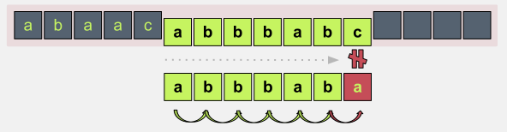
Pencocokan String
(String/Pattern Matching)
Bahan Kuliah IF2211 Strategi Algoritma
Program Studi Teknik Informatika
STEI-ITB

Slide 2
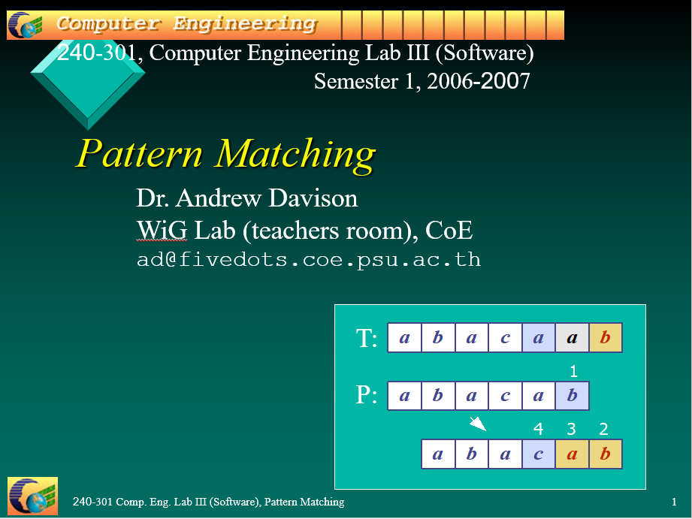
Referensi untuk slide ini diambil dan diadaptasi dari:
Dr. Andrew Davison, Pattern Matching, WiG Lab (teachers room), CoE
(Updated by: Dr. Rinaldi Munir, Informatika STEI-ITB)

Slide 3
Overview
1. What is Pattern Matching?
2. The Brute Force Algorithm
3. The Knuth-Morris-Pratt Algorithm
4. The Boyer-Moore Algorithm
5. More Information

Slide 4
What is Pattern Matching?
Definisi: Diberikan:
1. T: teks (text), yaitu (long) string yang panjangnya n karakter
2. P: pattern, yaitu string dengan panjang m karakter (asumsi m <<< n) yang akan dicari di dalam teks.
Carilah (find atau locate) lokasi pertama di dalam teks yang bersesuaian dengan pattern.
Contoh:
    T: the rain in spain stays mainly on the plain
    P: main

Slide 5
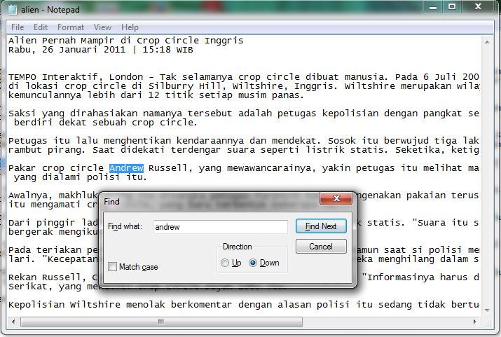
Aplikasi:
1. Pencarian di dalam Editor Text

Slide 6
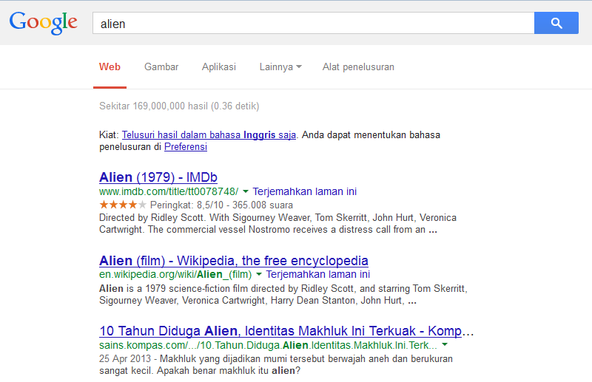
2. Web search engine (Misal: Google)

Slide 7
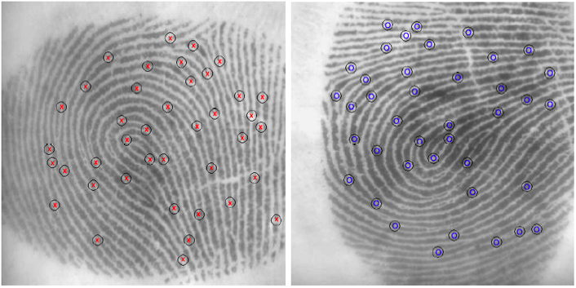
3. Analisis Citra

Slide 8
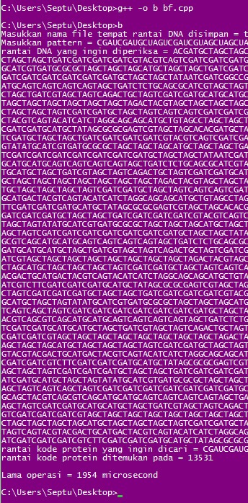
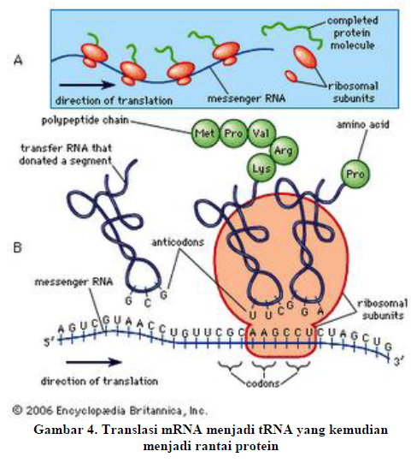
4. Bionformatics
Pencocokan Rantai Asam Amino pada
rantai DNA
Sumber: Septu Jamasoka, IF2009

Slide 9
String Concepts
Assume S is a string of size m.
S = x₀x₁ … x_{m – 1}
A prefix of S is a substring S[0 .. k]
A suffix of S is a substring S[k .. m – 1]
  k is any index between 0 and m – 1

Slide 10
Examples
S
a
n
d
r
e
w
0
5
All possible prefixes of S:
  “a", "an", "and", "andr”, "andre“, "andrew“
All possible suffixes of S:
  ”w”, “ew", “rew", “drew", “ndrew” , "andrew“

Slide 11
2. The Brute Force Algorithm
Check each position in the text T to see if the pattern P
starts in that position
T:
a
n
d
r
e
w
T:
a
n
d
r
e
w
P:
r
e
w
P:
r
e
w
P moves 1 char at a time through T
. . . .

Slide 12
Teks: NOBODY NOTICED HIM
Pattern: NOT
NOBODY NOTICED HIM
1 NOT
2 NOT
3 NOT
4 NOT
5 NOT
6 NOT
7 NOT
8 NOT

Slide 13
Brute Force in Java
Return index where
pattern starts, or -1
public static int brute(String text,String pattern)
{ int n = text.length(); // n is length of text
int m = pattern.length(); // m is length of pattern
int j;
for(int i=0; i <= (n-m); i++) {
j = 0;
while ((j < m) && (text.charAt(i+j)== pattern.charAt(j)))
{
j++;
}
if (j == m)
return i; // match at i
}
return -1; // no match
}// end of brute()

Slide 14
Usage
public static void main(String args[])
{ if (args.length != 2) {
System.out.println("Usage: java BruteSearch
<text> <pattern>");
System.exit(0);
}
System.out.println("Text: " + args[0]);
System.out.println("Pattern: " + args[1]);
int posn = brute(args[0], args[1]);
if (posn == -1)
System.out.println("Pattern not found");
else
System.out.println("Pattern starts at posn “ + posn);
}

Slide 15
Analysis
Worst Case.
Jumlah perbandingan: m(n – m + 1) = O(mn)
Contoh:
  T: aaaaaaaaaaaaaaaaaaaaaaaaaah
  P: aaah

Slide 16
Best case
Kompleksitas kasus terbaik adalah O(n).
Terjadi bila karakter pertama pattern P tidak pernah sama dengan karakter di dalam teks T yang dicocokkan
Jumlah perbandingan maksimal n kali:
Contoh:
T: String ini berakhir dengan zzz
P: zzz

Slide 17
Average Case
But most searches of ordinary text take O(m+n), which is very quick.
Example of a more average case:
  T: a string searching example is standard
  P: store

Slide 18
The brute force algorithm is fast when the alphabet of the
text is large
  e.g. A..Z, a..z, 1..9, etc.
It is slower when the alphabet is small
  e.g. 0, 1 (as in binary files, image files, etc.)

Slide 19
2. The KMP Algorithm
The Knuth-Morris-Pratt (KMP) algorithm looks for the pattern in the text in a left-to-right order (like the brute force algorithm).
But it shifts the pattern more intelligently than the brute force algorithm.

Slide 20

Donald E. Knuth
Donald Ervin Knuth (born January 10, 1938) is a computer scientist and Professor Emeritus at Stanford University. He is the author of the seminal multi-volume work The Art of Computer Programming.^{[3]} Knuth has been called the "father" of the analysis of algorithms. He contributed to the development of the rigorous analysis of the computational complexity of algorithms and systematized formal mathematical techniques for it. In the process he also popularized the asymptotic notation.

Slide 21
If a mismatch occurs between the text and pattern P at P[j], i.e T[i] ≠ P[j], what is the most we can shift the pattern to avoid wasteful comparisons?
Answer: the largest prefix of P[0 .. j-1] that is a suffix of P[1 .. j-1]

Slide 22
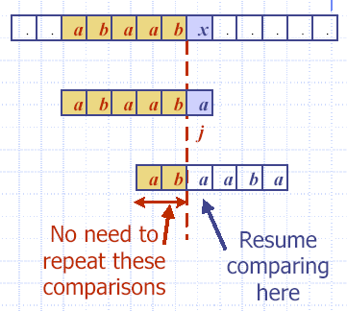
Example
i
0 1 2 3 4 5 6 7 8 9 10 11 12
T:
0 1 2 3 4 5
P:
j = 5
0 1 2 3 4 5
j_{new} = 2

Slide 23
Why
Find largest prefix (start) of:
abaab ( P[0..4] )
which is suffix (end) of:
abaab ( P[1.. 4])
Answer: ab → panjang = 2
Set j = 2 // the new j value to begin comparison
Jumlah pergeseran:
s = length(abbab) – length(ab)
= 5 – 2 = 3

Slide 24
b
a
c
b
a
b
a
b
a
a
b
c
b
a
T
s
a
b
a
b
a
c
a
P
q
b
a
c
b
a
b
a
b
a
a
b
c
b
a
T
s’
a
b
a
b
a
c
a
P
k
a
b
a
b
a
P_{q}
Longest prefix of P_{q} that is also a suffix of P_{q} is ‘aba’; so b[4]= 3
a
b
a
P_{k}

Slide 25
Fungsi Pinggiran KMP (KMP Border Function)
KMP preprocesses the pattern to find matches of prefixes of the pattern with the pattern itself.
j = mismatch position in P[]
k = position before the mismatch (k = j – 1).
The border function b(k) is defined as the size of the largest prefix of P[0..k] that is also a suffix of P[1..k].
The other name: failure function (disingkat: fail)

Slide 26
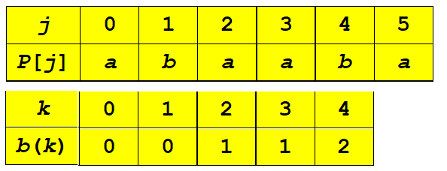
Border Function Example
(k = j-1)
P: abaaba
j: 012345
In code, b() is represented by an array, like the table.
b(k) is the size of the largest border.
Hint: The border function b(k) is defined as the size of the largest prefix of P[0..k] that is also a suffix of P[1..k].

Slide 27
Why is b(4) == 2?
P: "abaaba"
b(4) means
  find the size of the largest prefix of P[0..4] that is also a suffix of P[1..4]
  find the size largest prefix of "abaab" that is also a suffix of "baab“
  find the size of "ab"
  == 2
(k = j-1)

Slide 28
Contoh lain: P = ababababca
j = 0123456789
(k = j-1)
j | 0 | 1 | 2 | 3 | 4 | 5 | 6 | 7 | 8 | 9
P [j] | a | b | a | b | a | b | a | b | c | a
k | 0 | 1 | 2 | 3 | 4 | 5 | 6 | 7 | 8
b[k] | 0 | 0 | 1 | 2 | 3 | 4 | 5 | 6 | 0

Slide 29
Using the Border Function
Knuth-Morris-Pratt’s algorithm modifies the brute-force algorithm.
  if a mismatch occurs at P[j]
  (i.e. P[j] != T[i]), then
  k = j-1;
  j = b(k); // obtain the new j

Slide 30
KMP in Java
Return index where
pattern starts, or -1
public static int kmpMatch(String text,
String pattern)
{
int n = text.length();
int m = pattern.length();
int b[] = computeBorder(pattern);
int i=0;
int j=0;
:

Slide 31
while (i < n) {
if (pattern.charAt(j) == text.charAt(i)) {
if (j == m - 1)
return i - m + 1; // match
i++;
j++;
}
else if (j > 0)
j = b[j-1];
else
i++;
}
return -1; // no match
}// end of kmpMatch()

Slide 32
public static int[] computeBorder(String pattern)
{
int b[] = new int[pattern.length()];
fail[0] = 0;
int m = pattern.length();
int j = 0;
int i = 1;
:

Slide 33
while (i < m) {
if (pattern.charAt(j) == pattern.charAt(i)) {
//j+1 chars match
b[i] = j + 1;
i++;
j++;
}
else if (j > 0) // j follows matching prefix
j = b[j-1];
else { // no match
b[i] = 0;
i++;
}
}
return fail;
}// end of computeBorder()
Similar code
to kmpMatch()

Slide 34
Usage
public static void main(String args[])
{ if (args.length != 2) {
System.out.println("Usage: java KmpSearch
<text> <pattern>");
System.exit(0);
}
System.out.println("Text: " + args[0]);
System.out.println("Pattern: " + args[1]);
int posn = kmpMatch(args[0], args[1]);
if (posn == -1)
System.out.println("Pattern not found");
else
System.out.println("Pattern starts at posn "
+ posn);
}

Slide 35
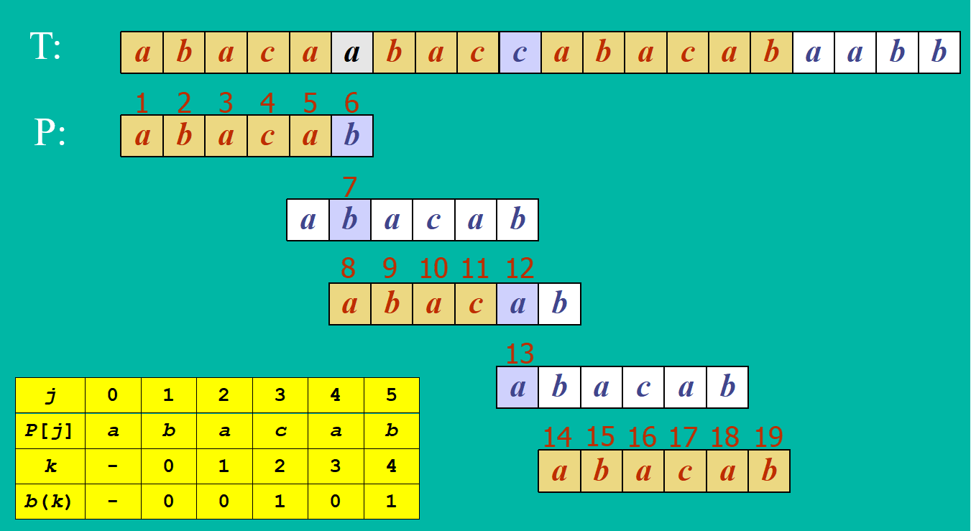
Example
0
2
3
4
0
1
0
1
Jumlah perbandingan karakter: 19 kali

Slide 36
Why is b(4) == 1?
P: "abacab"
b(4) means
  find the size of the largest prefix of P[0..4] that is also a suffix of P[1..4]
  = find the size largest prefix of "abaca" that is also a suffix of "baca”
  = find the size of "a“
  = 1

Slide 37
Kompleksitas Waktu KMP
Menghitung fungsi pinggiran : O(m),
Pencarian string : O(n)
Kompleksitas waktu algoritma KMP adalah O(m+n).
- sangat cepat dibandingkan brute force

Slide 38
KMP Advantages
The algorithm never needs to move backwards in the input text, T
  this makes the algorithm good for processing very large files that are read in from external devices or through a network stream

Slide 39
KMP Disadvantages
KMP doesn’t work so well as the size of the alphabet increases
  more chance of a mismatch (more possible mismatches)
  mismatches tend to occur early in the pattern, but KMP is faster when the mismatches occur later

Slide 40
KMP Extensions
The basic algorithm doesn't take into account the letter in the text that caused the mismatch.
T:
a
b
a
a
b
x
Basic KMP
does not do this.
P:
a
b
a
a
b
a
a
b
a
a
b
a

Slide 41
Latihan
Diberikan sebuah text: abacaabacabacababa dan pattern: acabaca
Hitung fungsi pinggiran
Gambarkan proses pencocokan string dengan algoritma KMP sampai pattern ditemukan
Berapa jumlah perbandingan karakter yang terjadi?

Slide 42
3. The Boyer-Moore Algorithm
The Boyer-Moore pattern matching algorithm is based on two techniques.
1. The looking-glass technique
  find P in T by moving backwards through P, starting at its end

Slide 43
2. The character-jump technique
  when a mismatch occurs at T[i] == x
  the character in pattern P[j] is not the same as T[i]
There are 3 possible
cases, tried in order.
T
x
a
i
P
b
a
j

Slide 44
Case 1
If P contains x somewhere, then try to shift P right to align the last occurrence of x in P with T[i].
T
T
?
x
a
x
a
?
i
i_{new}
and
move i and
j right, so
j at end
P
P
x
c
b
a
x
c
b
a
j
j_{new}

Slide 45
Case 2
If P contains x somewhere, but a shift right to the last occurrence is not possible, then shift P right by 1 character to T[i+1].
T
T
?
x
a
x
x
a
x
i
i_{new}
and
move i and
j right, so
j at end
P
P
c
w
a
x
c
w
a
x
j
j_{new}
x is after
j position

Slide 46
Case 3
If cases 1 and 2 do not apply, then shift P to align P[0] with T[i+1].
T
T
x
a
x
a
?
?
?
i
i_{new}
and
move i and
j right, so
j at end
P
P
d
c
b
a
d
c
b
a
j
0
j_{new}
No x in P

Slide 47
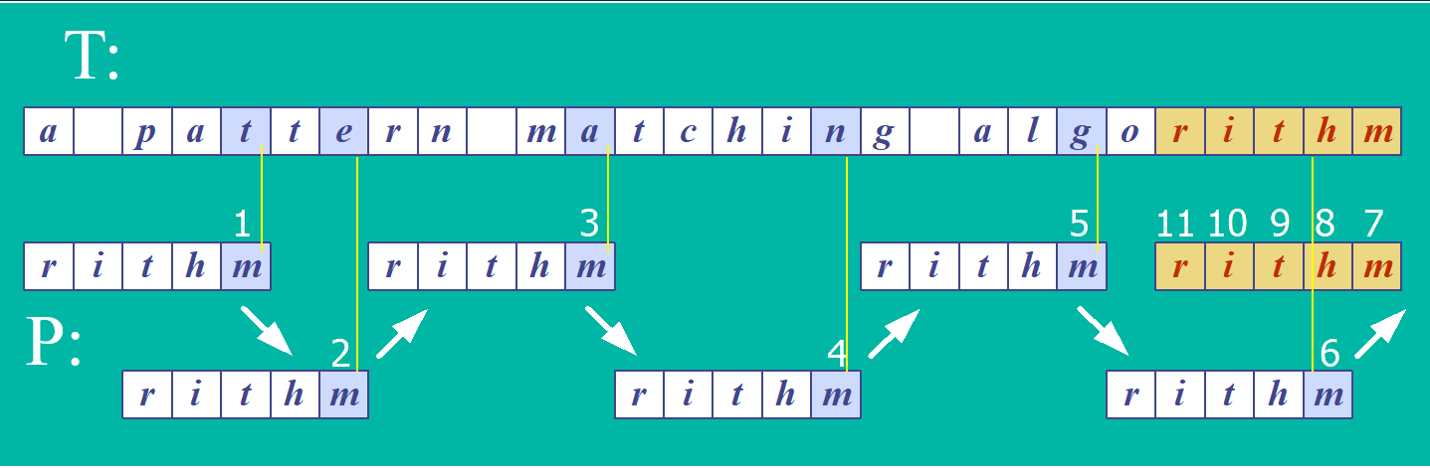
Boyer-Moore Example (1)
Jumlah perbandingan karakter: 11 kali

Slide 48
Last Occurrence Function
Boyer-Moore’s algorithm preprocesses the pattern P and the alphabet A to build a last occurrence function L()
  L() maps all the letters in A to integers
L(x) is defined as: // x is a letter in A
  the largest index i such that P[i] == x, or
  -1 if no such index exists

Slide 49
L() Example
P
a
b
a
c
a
b
A = {a, b, c, d}
P: "abacab"
0
1
2
3
4
5
x
a
b
c
d
L(x)
4
5
3
-1
L() stores indexes into P[]

Slide 50
Note
In Boyer-Moore code, L() is calculated when the pattern P is read in.
Usually L() is stored as an array
  something like the table in the previous slide

Slide 51
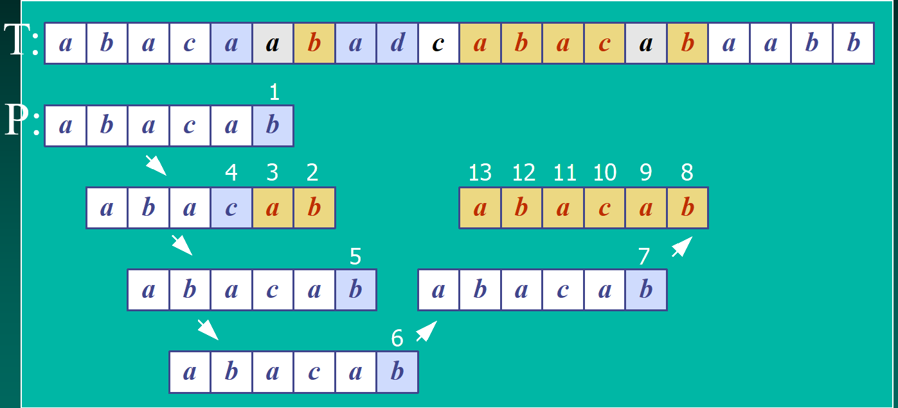
Boyer-Moore Example (2)
x
a
b
c
d
Jumlah perbandingan karakter: 13 kali
L(x)
4
5
3
-1

Slide 52
Boyer-Moore in Java
Return index where
pattern starts, or -1
public static int bmMatch(String text,
String pattern)
{
int last[] = buildLast(pattern);
int n = text.length();
int m = pattern.length();
int i = m-1;
if (i > n-1)
return -1; // no match if pattern is
// longer than text
:

Slide 53
int j = m-1;
do {
if (pattern.charAt(j) == text.charAt(i))
if (j == 0)
return i; // match
else { // looking-glass technique
i--;
j--;
}
else { // character jump technique
int lo = last[text.charAt(i)]; //last occ
i = i + m - Math.min(j, 1+lo);
j = m - 1;
}
} while (i <= n-1);
return -1; // no match
} // end of bmMatch()

Slide 54
public static int[] buildLast(String pattern)
/* Return array storing index of last
occurrence of each ASCII char in pattern. */
{
int last[] = new int[128]; // ASCII char set
for(int i=0; i < 128; i++)
last[i] = -1; // initialize array
for (int i = 0; i < pattern.length(); i++)
last[pattern.charAt(i)] = i;
return last;
} // end of buildLast()

Slide 55
Usage
public static void main(String args[])
{ if (args.length != 2) {
System.out.println("Usage: java BmSearch
<text> <pattern>");
System.exit(0);
}
System.out.println("Text: " + args[0]);
System.out.println("Pattern: " + args[1]);
int posn = bmMatch(args[0], args[1]);
if (posn == -1)
System.out.println("Pattern not found");
else
System.out.println("Pattern starts at posn "
+ posn);
}

Slide 56
Analysis
Boyer-Moore worst case running time is O(nm + A)
But, Boyer-Moore is fast when the alphabet (A) is large,
slow when the alphabet is small.
  e.g. good for English text, poor for binary
Boyer-Moore is significantly faster than brute force for searching English text.

Slide 57
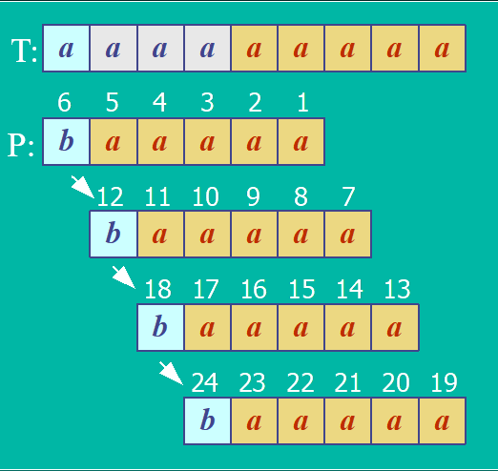
Worst Case Example
T: "aaaaa…a"
P: "baaaaa"
Jumlah perbandingan karakter: 24 kali

Slide 58
5. More Information
This book is
in the CoE library.
Algorithms in C++
Robert Sedgewick
Addison-Wesley, 1992
  chapter 19, String Searching
Online Animated Algorithms:
  http://www.ics.uci.edu/~goodrich/dsa/
  11strings/demos/pattern/
  http://www-sr.informatik.uni-tuebingen.de/
  ~buehler/BM/BM1.html
  http://www-igm.univ-mlv.fr/~lecroq/string/

Slide 59
Latihan soal
Pencocokan String

Slide 60
UAS 2023
(a) Berikan contoh sebuah pattern sepanjang 5 karakter dan teks sepanjang > 10 karakter sedemikian sehingga algoritma pencocokan string dengan KMP sama jumlah perbandingan karakternya dengan algoritma brute force pada kasus terburuk. Perlihatkan proses pencocokannya dan jumlah perbandingan karakter pada masing-masing algoritma.
(b) Diberikan teks sebagai berikut:WELCOMETOMYCOALLISION. Carilah pattern COAL dengan algoritma Boyer-Moore. Dalam menjawab soal ini, perlihatkan proses pencocokan stringnya, hitung last occurance, dan hitung jumlah perbandingan karakter yang terjadi

Slide 61
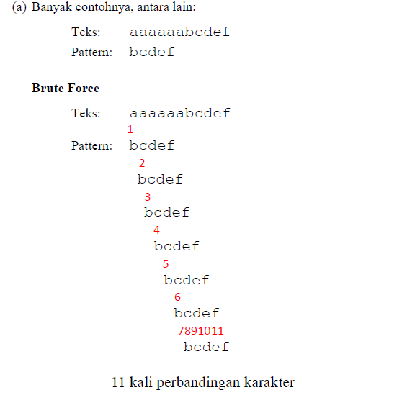
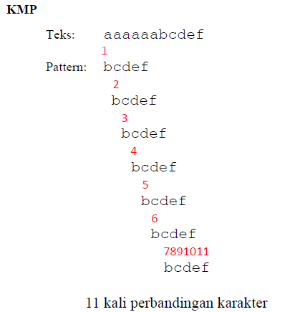
Jawaban:

Slide 62
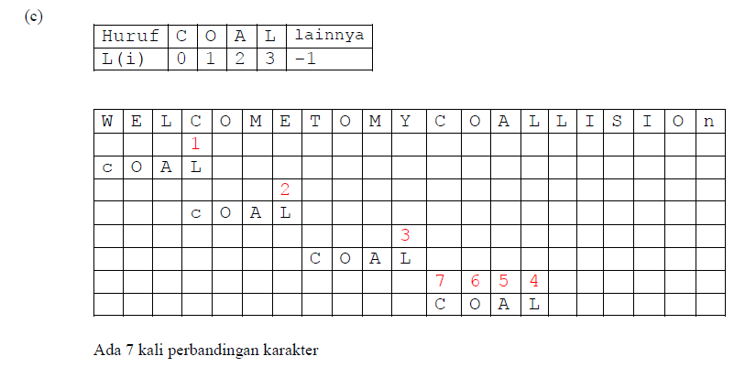

Slide 63
UAS 2019
Diberikan P = 10010001 dan T = 100100100100010111. Gambarkan/perlihatkan proses pencocokan string P pada teks T masing-masing dengan algoritma Brute Force, KMP, dan Boyer- Moore. Gunakan angka-angka 1, 2, 3, …untuk memperlihatkan jumlah perbandingan (seperti slide kuliah). Berapa jumlah perbandingan karakter yang terjadi?

Slide 64
SELAMAT BELAJAR

