Slide 1
Route/Path Planning
Bagian 2: Algoritma A*
IF221 Strategi Algoritma
Program Studi Informatika
STEI-ITB

Slide 2
Referensi
Materi kuliah IF3170 Inteligensi Buatan Teknik Informatika ITB, Course Website:
  http://kuliah.itb.ac.id → STEI → Teknik Informatika → IF3170
Stuart J Russell & Peter Norvig, Artificial Intelligence: A Modern Approach, 3rd Edition, Prentice-Hall International, Inc, 2010, Textbook
Site: http://aima.cs.berkeley.edu/ (2nd edition)
Free online course materials | MIT OpenCourseWare Website:
Site: http://ocw.mit.edu/courses/electrical-engineering-and-computer-science/
Lecture Notes in Informed Heuristic Search, ICS 271 Fall 2008, http://www.ics.uci.edu/~dechter/courses/ics-271/fall-08/lecture-notes/4.InformedHeuristicSearch.ppt

Slide 3

Route Planning

Slide 4
Search
Source: Russell’s book
O
71
151
F
S
99
Z
75
211
A
140
80
R
B
97
P
120
118
101
D
75
S: set of cities
i.s: A (Arad)
g.s: B (Bucharest)
Goal test: s = B ?
Path cost: time ~ distance
T
M
146
138
111
L
70
C
Persoalan: Carilah lintasan terpendek dari Arad (A) ke Bucharest (B)!

Slide 5
Heuristic Search
Heuristic estimates value of a node
  promise of a node
  difficulty of solving the subproblem
  quality of solution represented by node
  the amount of information gained
f(n)- heuristic evaluation function.
  depends on n, goal, search so far, domain

Slide 6
A* Search
Idea: avoid expanding paths that are already expensive
Evaluation function f(n) = g(n) + h(n)
g(n) = cost so far to reach n
h(n) = estimated cost from n to goal
f(n) = estimated total cost of path through n to goal
if f(n) = g(n) → Uniform Cost Search (UCS)
if f(n) = h(n) → Greedy Best First Search
if f(n) = g(n) + h(n) → A*
root
g(n)
n
h(n)
goal

Slide 7

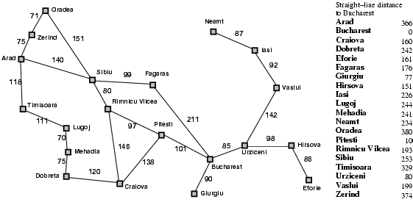
A* search example
f(n) = g(n) + h(n)
g(n) = distance from Arad to n
h(n) = straight-line distance from n to Bucharest

Slide 8
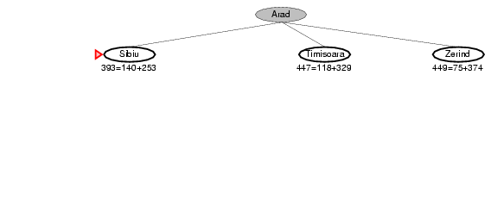
A* search example
f(n) = g(n) + h(n)
g(n) = distance from Arad to n
h(n) = straight-line distance from n to Bucharest

Slide 9
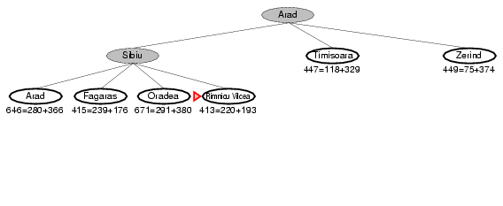
A* search example
f(n) = g(n) + h(n)
g(n) = distance from Arad to n
h(n) = straight-line distance from n to Bucharest

Slide 10
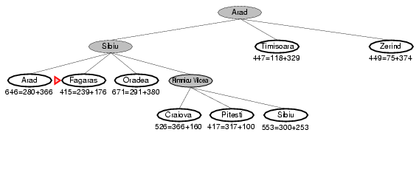
A* search example
f(n) = g(n) + h(n)
g(n) = distance from Arad to n
h(n) = straight-line distance from n to Bucharest

Slide 11
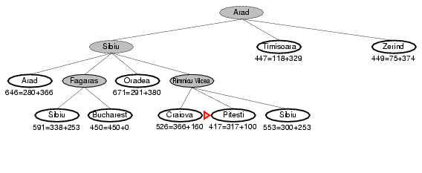
A* search example
f(n) = g(n) + h(n)
g(n) = distance from Arad to n
h(n) = straight-line distance from n to Bucharest

Slide 12
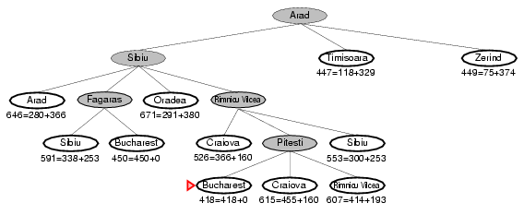
A* search example
f(n) = g(n) + h(n)
g(n) = distance from Arad to n
h(n) = straight-line distance from n to Bucharest

Slide 13
A* Special
root
g(n)
n
Goal: find a minimum sum-cost path
Notation:
  c(n,n’) - cost of arc (n,n’)
  g(n) = cost of current path from start to node n in the search tree.
  h(n) = estimate of the cheapest cost of a path from n to a goal.
  Special evaluation function: f = g+h
f(n) estimates the cheapest cost solution path that goes through n.
  h*(n) is the true cheapest cost from n to a goal.
  g*(n) is the true shortest path from the start s, to n.
If the heuristic function, h always underestimate the true cost (h(n) is smaller than h*(n)), then A* is guaranteed to find an optimal solution → admissible; and also has to be consistent
h(n)
f(n) = g(n) + h(n)
goal

Slide 14
Properties of A*
Complete? Yes, unless there are infinitely many nodes with f ≤ f(G)
Time? Exponential: O(b^{m})
Space? Keep all the nodes in memory: O(b^{m})
Optimal? Yes

Slide 15
Branch-and-Bound vs A*
As in A*, look for a bound which is guaranteed lower than the true cost
Search the branching tree in any way you like
  e.g. depth first (no guarantee), best first
Cut off search if cost + bound > best solution found
If heuristic is cost + bound, search = best first
  then B&B = A*
Bounds often much more sophisticated
  e.g. using mathematical programming optimisations

Slide 16
Admissible heuristics
A heuristic h(n) is admissible if for every node n, h(n) ≤ h*(n), where h*(n) is the true cost to reach the goal state from n.
An admissible heuristic never overestimates the cost to reach the goal, i.e., it is optimistic
Example: h_{SLD}(n) (never overestimates the actual road distance)
Theorem: If h(n) is admissible, A* using TREE-SEARCH is optimal

Slide 17
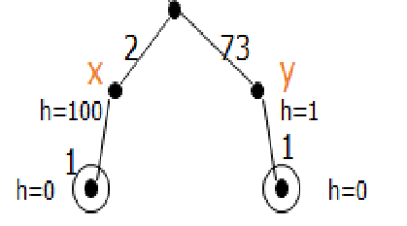
Admissibility
What must be true about h for A* to find optimal path?
A* finds optimal path if h is admissable; h is admissible when it never overestimates.
In this example, h is not admissible.
In route finding problems, straight-line distance to goal is admissible heuristic.
g(X)+h(X)=2+100=102
G(Y)+h(Y)=73+1=74
Optimal path is not found!
Because we choose Y, rather than X which is in the optimal path.

Slide 18
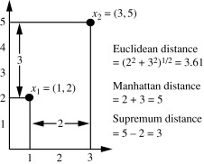
Latihan soal A*
Terdapat persoalan 8-puzzle seperti pada Gambar 1. Gambar 1(a) adalah start state persoalan, dan gambar 1(b) adalah goal state. Ubin yang dapat bergerak adalah ubin kosong, dengan urutan pergerakan (jika diperlukan) adalah kiri, kanan, atas, bawah. Selesaikan persoalan 8-puzzle tersebut dengan teknik A*. Biaya suatu state dari start state adalah banyaknya langkah ubin kosong yang telah dilakukan. Jika diperlukan heuristik, maka digunakan jumlah manhattan distance semua ubin selain ubin kosong. Manhattan distance sebuah ubin adalah banyaknya ubin secara horisontal dan vertikal terdekat untuk menuju posisi ubin yang sesuai

Slide 19
Tuliskan langkah-langkah penyelesaiannya dengan menggambarkan pohon ruang pencarian, dan di setiap simpul pohon tunjukkan perhitungan nilai fungsi evaluasinya (yang menjadi penentu state berikutnya yang harus diperiksa).
State yang sudah pernah dilalui tidak perlu diperiksa kembali. Setelah pencarian selesai, tuliskan langkah pergeseran ubin kosong dari start state hingga goal state.
Asumsi: status tujuan selalu dapat dicapai dari status awal.
Penyelesaian:
f(n) = g(n) + h(n)
g(n) = jumlah langkah ubin kosong yang telah dilakukan
h(n) = jumlah manhattan distance semua ubin selain ubin kosong.
(Manhattan distance sebuah ubin adalah banyaknya ubin secara horisontal dan vertikal terdekat untuk menuju posisi ubin yang sesuai)

Slide 20
Initial state
Goal state

Slide 21
Contoh Soal UAS Sem 2 2014/2015
Dalam permainan video game, adakalanya entitas bergerak dalam video game perlu berpindah dari satu posisi ke posisi lain. Seringkali proses perpindahan perlu mengutamakan jalur terdekat atau biaya minimal karena berhubungan dengan poin yang diperoleh. Gambar di bawah ini menunjukkan contoh jalur yang mungkin dilewati oleh entitas bergerak dalam suatu video game. Suatu entitas akan berpindah dari posisi titik A menuju ke posisi titik F. Jika diperlukan informasi heuristik, nilai heuristik dari suatu simpul adalah banyaknya busur minimal yang menghubungkan titik tersebut ke titik tujuan.

Slide 22
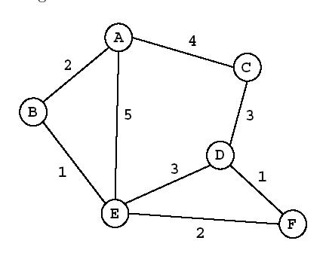
Contoh Soal UAS Sem 2 2014/2015 (2)
Pencarian solusi dengan:
UCS
Greedy Best First
A Star
Untuk masing-masing pendekatan tuliskan:
Formula
Iterasi
  Simpul yang diekspansi
  Simpul hidup & nilai f(n)
Urut abjad, simpul ekspan tidak mengulang, tidak membentuk sirkuit, berhenti saat satu solusi ditemukan

Slide 23
Solusi:

Slide 26
Selamat Belajar

