Slide 1
Penentuan Rute (Route/Path Planning) Bagian 1: BFS, DFS, UCS, Greedy Best First Search
IF221 Strategi Algoritma
Program Studi Informatika
STEI-ITB

Slide 2
Referensi
Materi kuliah IF3170 Inteligensi Buatan Teknik Informatika ITB, Course Website:
http://kuliah.itb.ac.id → STEI → Teknik Informatika → IF3170
Stuart J Russell & Peter Norvig, Artificial Intelligence: A Modern Approach, 3rd Edition, Prentice-Hall International, Inc, 2010, Textbook
Site: http://aima.cs.berkeley.edu/ (2nd edition)
Free online course materials | MIT OpenCourseWare Website: Site: http://ocw.mit.edu/courses/electrical-engineering-and-computer-science/
Lecture Notes in Informed Heuristic Search, ICS 271 Fall 2008, http://www.ics.uci.edu/~dechter/courses/ics-271/fall-08/lecture-notes/4.InformedHeuristicSearch.ppt

Slide 3
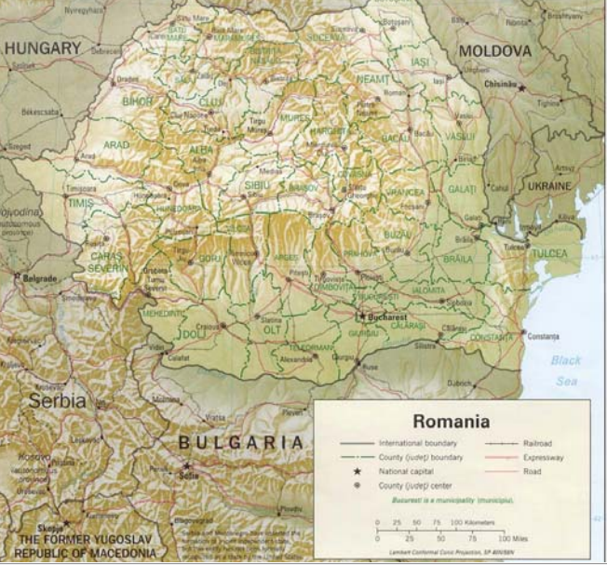
Route Planning

Slide 4
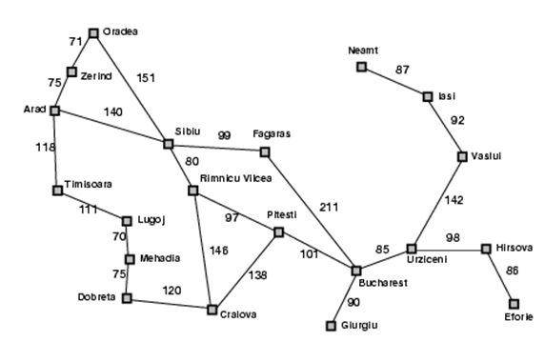

Slide 5
Search
Source: Russell’s book
O
71
151
F
S
99
Z
75
211
A
140
80
R
B
97
P
120
118
101
D
75
T
M
146
138
111
L
70
C
(a part of graph of Romania)
S: set of cities
i.s: A (Arad)
g.s: B (Bucharest)
Goal test: s = B ?
Path cost: time ~ distance

Slide 6
Uninformed Search
Blind Search
BFS (Breadth First Search)
DFS (Depth First Search)
DLS (Deep Limited Search)
IDS (Iterative Deepening Search)
UCS (Uniform Cost Search)

Slide 7
Breadth-First Search (BFS)
Pohon BFS
A
Treat agenda as a queue (FIFO)
Z
S
T
O
O
71
151
S
F
O
F
R
L
Z
99
75
211
Goal
B
C
P
M
A
140
80
R
B
Simpul-E | Simpul Hidup
A | Z_{A},S_{A},T_{A}
Z_{A} | S_{A},T_{A},O_{AZ}
S_{A} | T_{A},O_{AZ},O_{AS},F_{AS},R_{AS}
T_{A} | O_{AZ},O_{AS},F_{AS},R_{AS},L_{AT}
O_{AZ} | O_{AS},F_{AS},R_{AS},L_{AT}
O_{AS} | F_{AS},R_{AS},L_{AT}
F_{AS} | R_{AS},L_{AT},B_{ASF}
R_{AS} | L_{AT},B_{ASF},D_{ASR},C_{ASR},P_{ASR}
L_{AT} | B_{ASF},D_{ASR},C_{ASR},P_{ASR},M_{ATL}
B_{ASF} | Solusi ketemu
97
P
120
101
118
D
75
138
T
70
M
146
111
L
C
Queue
Path: A→ S → F → B, Path-cost = 450

Slide 8
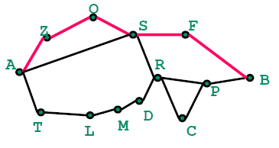
Depth-First Search (DFS)
A
Pohon DFS
Treat agenda as a stack (LIFO)
Z
S
T
O
Z
71
151
S
F
99
O
75
211
A
S
140
80
R
B
97
P
120
F
R
118
101
D
75
T
70
M
146
138
B
Goal
Stack
111
L
C
Simpul-E | Simpul Hidup
A | Z_{A},S_{A},T_{A}
Z_{A} | O_{AZ}, S_{A},T_{A}
O_{AZ} | S_{AZO},S_{A},T_{A}
S_{AZO} | F_{AZOS}, R_{AZOS},S_{A},T_{A}
F_{AZOS} | B_{AZOSF}, R_{AZOS},S_{A},T_{A}
B_{AZOSF} | Solusi ketemu
Path: A→ Z → O → S → F → B
Path-cost = 607

Slide 9
Iterative Deepening Search (IDS)
Pohon IDS
Depth
A
0
Z
71
O
151
S
F
99
211
Z
S
T
1
75
A
140
80
R
B
O
F
R
L
2
97
P
120
118
101
B
D
Goal
3
75
T
M
146
138
111
L
70
C
Depth=0: A: cutoff
Depth=1: A → Z_{A},S_{A},T_{A} → Z_{A}: cutoff, S_{A}: cutoff, T_{A}: cutoff
Depth=2: A → Z_{A},S_{A},T_{A} → O_{AZ}, S_{A},T_{A} → O_{AZ} : cutoff → F_{AS}, R_{AS},T_{A} → F_{AS} : cutoff → R_{AS} : cutoff → L_{AT}
→ L_{AT} : cutoff
Depth=3: A → Z_{A},S_{A},T_{A} → O_{AZ}, S_{A},T_{A} → S_{AZO},S_{A},T_{A} → S_{AZO}: cutoff → F_{AS}, R_{AS},T_{A} → B_{ASF}, R_{AS},T_{A} → B_{ASF}
Stop: B=goal, path: A→ S → F → B, path-cost = 450

Slide 10
Uniform Cost Search (UCS)
Simpul-E | Simpul Hidup
A | Z_{A-75}, T_{A-118,} S_{A-140}
Z_{A-75} | T_{A-118}, S_{A-140},O_{AZ-146}
T_{A-118} | S_{A-140},O_{AZ-146},L_{AT-229}
S_{A-140} | O_{AZ-146},R_{AS-220}, L_{AT-229},F_{AS-239},O_{AS-291}
O_{AZ-146} | R_{AS-220}, L_{AT-229}, F_{AS-239},O_{AS-291}
R_{AS-220} | L_{AT-229}, F_{AS-239},O_{AS-291}, P_{ASR-317},D_{ASR-340},C_{ASR-366}
L_{AT-229} | F_{AS-239},O_{AS-291},M_{ATL-299}, P_{ASR-317},D_{ASR-340},C_{ASR-366}
F_{AS-239} | O_{AS-291},M_{ATL-299}, P_{ASR-317},D_{ASR-340},C_{ASR-366,} B_{ASF-450}
O_{AS-291} | M_{ATL-299}, P_{ASR-317},D_{ASR-340},C_{ASR-366,} B_{ASF-450}
M_{ATL-299} | P_{ASR-317},D_{ASR-340},D_{ATLM-364},C_{ASR-366,} B_{ASF-450}
P_{ASR-317} | D_{ASR-340},D_{ATLM-364},C_{ASR-366,} B_{ASRP-418}, C_{ASRP-455,} B_{ASF-450}
D_{ASR-340} | D_{ATLM-364},C_{ASR-366,} B_{ASRP-418}, C_{ASRP-455,} B_{ASF-450}
D_{ATLM-364} | C_{ASR-366,} B_{ASRP-418}, C_{ASRP-455,} B_{ASF-450}
C_{ASR-366} | B_{ASRP-418}, C_{ASRP-455,} B_{ASF-450}
B_{ASRP-418} | Solusi ketemu
BFS & IDS find path with fewest steps (A-S-F-B)
If steps ≠ cost, this is not relevant (to optimal solution)
How can we find the shortest path (measured by sum of distances along path)?
g(n) = path cost from root to n
Z
71
O
151
S
99
F
75
211
A
80
140
R
97
P
B
120
118
101
D
M
75
146
138
T
111
L
70
C
Path: A→ S → R → P → B
Path-cost = 418 → optimal solution

Slide 11
Informed Search
Heuristic Search
Greedy Best First Search
A*

Slide 12
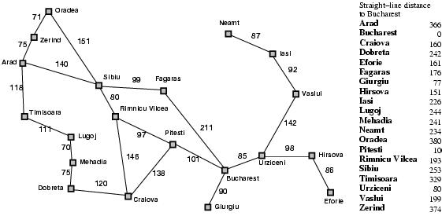
Greedy Best-First Search
Idea: use an evaluation function f(n) for each node
f(n) = h(n) → estimates of cost from n to goal
e.g., h_{SLD}(n) = straight-line distance from n to Bucharest
Greedy best-first search expands the node that appears to be closest to goal
Romania with step costs in km:

Slide 13
Greedy best-first search example

Slide 14
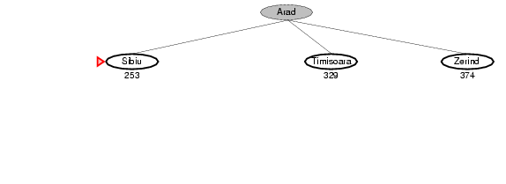
Greedy best-first search example

Slide 15
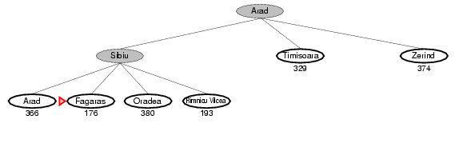
Greedy best-first search example

Slide 16
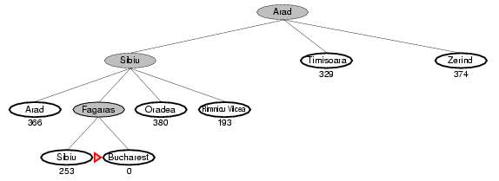
Greedy best-first search example
Path: Arad→ Sibiu → Fagaras → Bucharest, Path-cost = 450 → not optimal solution

Slide 17
Problems with Greedy Best First Search
Not complete
Lasi to Fragaras?

Slide 18
Problems with Greedy Best First Search
Get stuck with local minima/plateu
Irrevocable (not able to be reversed/changed)
Can we incorporate heuristics in systematic search?

Slide 19
(Bersambung pada Bagian 2)

