Slide 1
Topological Sort
(DFS,BFS, Decrease-and-Conquer)

Slide 2
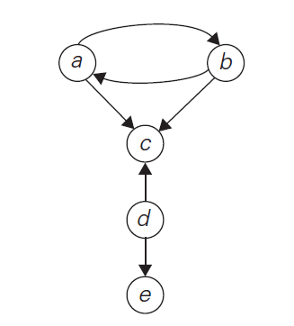
Directed Graph
What is Digraph (Directed Graph)
a graph with directions specified for all its edges
representation: adjacency matrix, adjacency lists (similar to undirected graph)
Example

Slide 3
Types of edges in DFS Forest
Undirected Graph: tree edge, back edge
Solid line: tree edge
Dashed line: back edge

Slide 4
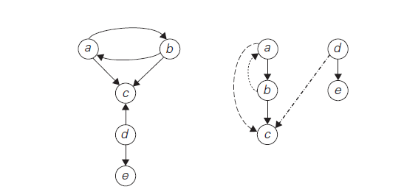
Types of edges in DFS Forest
Digraph has more complex type of edges:
tree edges (ab, bc, de)
ack edges (ba) from vertices to their ancestors
forward edges (ac) from vertices to their descendants in the tree other than their children,
cross edges (dc), which are none of the aforementioned types
A directed cycle in a digraph is a sequence of three or more of its vertices that starts and ends with the same vertex and in which every vertex is connected to its immediate predecessor by an edge directed from the predecessor to the successor → if a DFS forest of a digraph has no back edges, the digraph is a DAG (Directed Acyclic Graph)

Slide 5
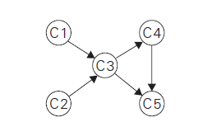
Topological Sort
Must be DAG
The question:
whether we can list its vertices in such an order that for every edge in the graph, the vertex where the edge starts is listed before the vertex where the edge ends → can we find an ordering of this digraph’s vertices
Example:

Slide 6
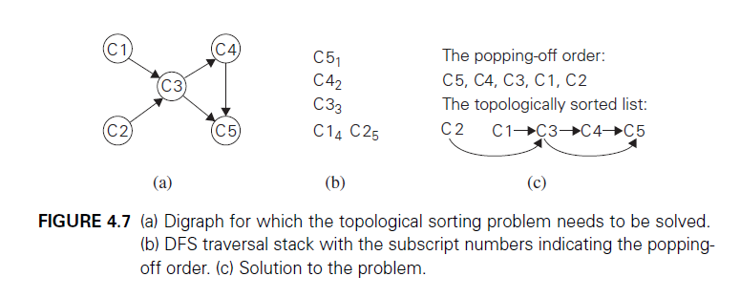
Topological Sort with DFS
Perform a DFS traversal
Note the order in which vertives become dead-ends (popped of the traversal stack)
Reverse the order → topological sort

Slide 7
Topological Sort with DFS
From DAG, counts in-degrees of each vertice
C1: 0
C2: 0
C3: 2
C4: 1
C5: 2
Choose arbitrary vertice which has 0 in-degrees (ex: C1)
Remove the vertice rom DAG, and remove all the edges from that vertice, then update the in-degrees of remaining vertices
Repeat step (2) until all vertices removed, the order od removal is the order of topological sort

Slide 8
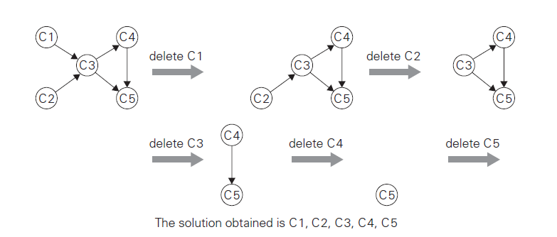
Topological Sort with Decrease and Conquer
Similar to BFS approach
Repeatedly, identify in a remaining digraph a source, which is a vertex with no incoming edges, and delete it along with all the edges outgoing from it.
If there are several sources, break the tie arbitrarily. If there are none, stop because the problem cannot be solved
The order in which the vertices are deleted yields a solution to the topological sorting problem.

Slide 9
Thank you

