Slide 1
String Matching dengan
Regular Expression
Masayu Leylia Khodra
Referensi:
Chapter 2 of An Introduction to Natural Language Processing, Computational Linguistics, and Speech Recognition, by Daniel Jurafsky and James H. Martin
15-211 Fundamental Data Structures and Algorithms, by Ananda Gunawardena

Slide 2
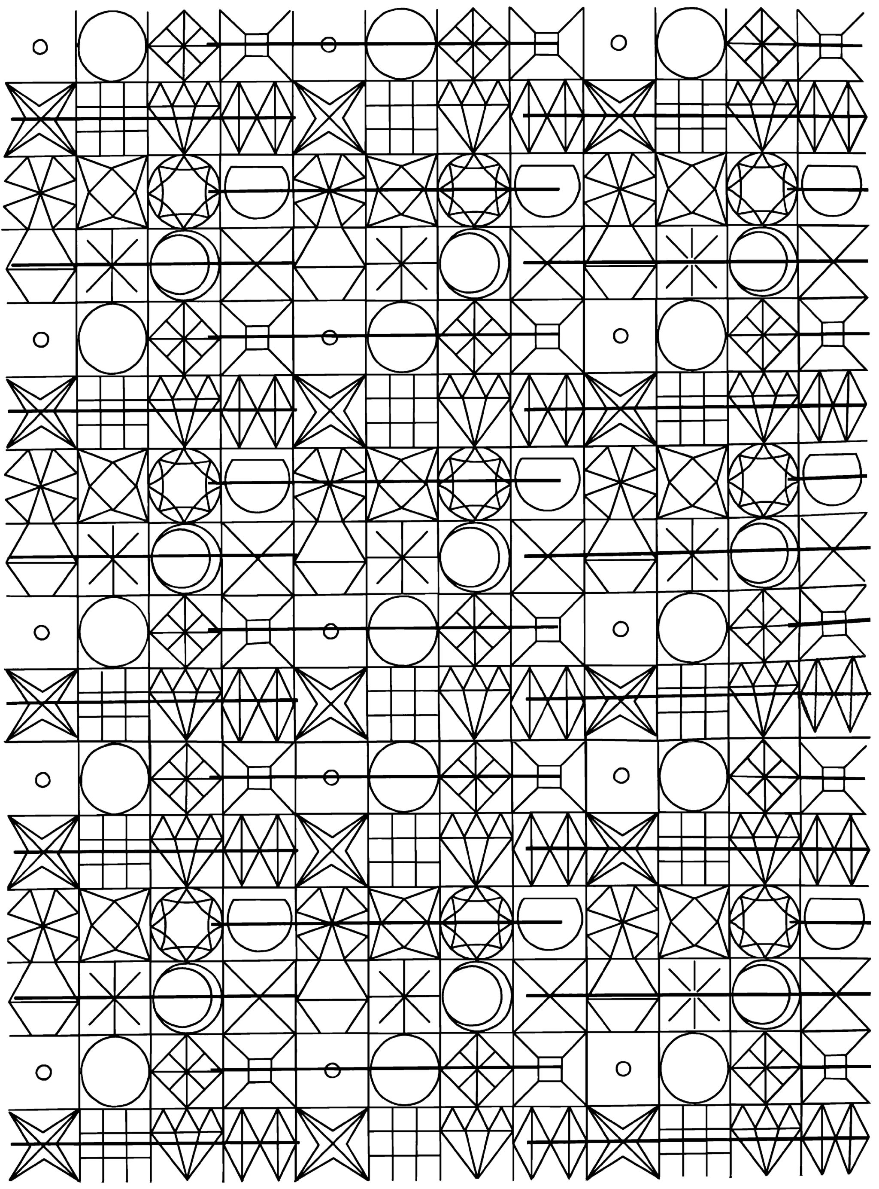
String Matching: Definisi
Diberikan:
T: teks (text), yaitu (long) string yang panjangnya n karakter
P: pattern, yaitu string dengan panjang m karakter (asumsi m <<< n) yang akan dicari di dalam teks.
Carilah (find atau locate) di dalam teks yang bersesuaian dengan pattern.

Slide 3
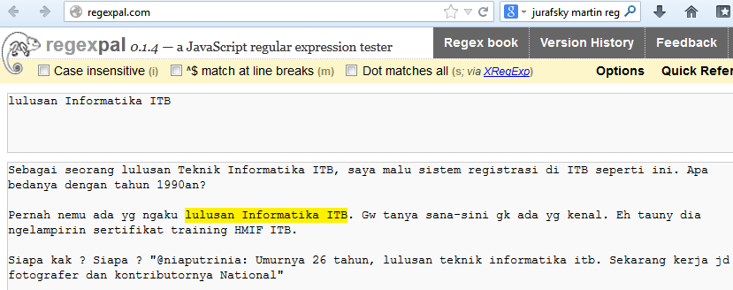
Contoh 1: Exact Matching

Slide 4
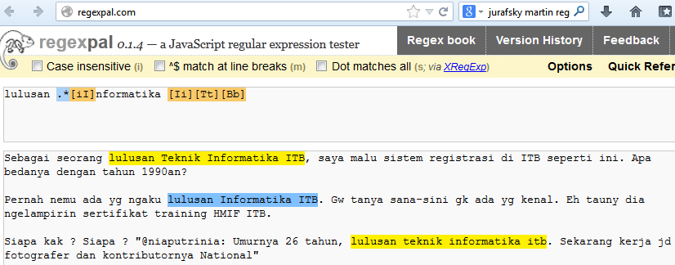
Contoh 2: Regex Matching

Slide 5
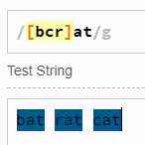
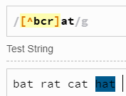
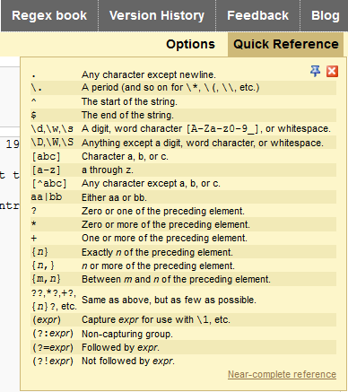
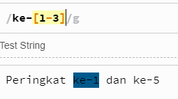
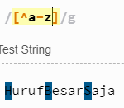
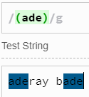
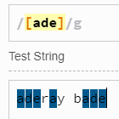
Notasi Umum Regex

Slide 6
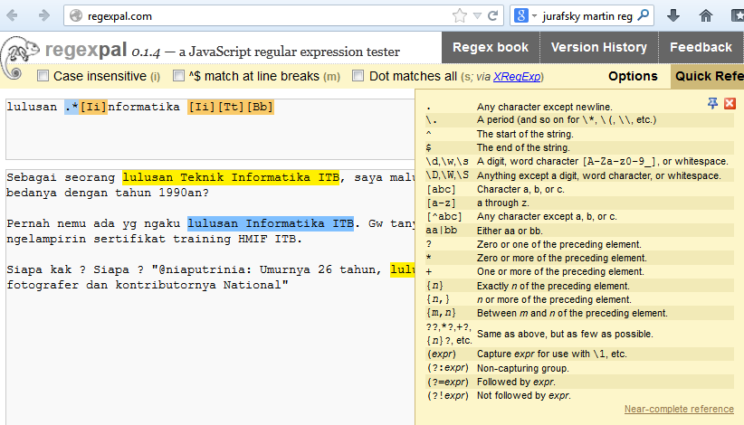
Contoh 2: Regex

Slide 7
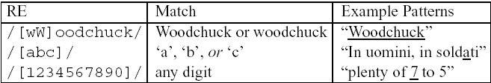
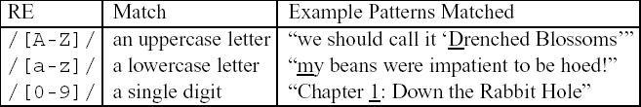
Basic Regular Expression Patterns
brackets []: disjunction
Brackets [] ditambah garis sambung: range

Slide 8
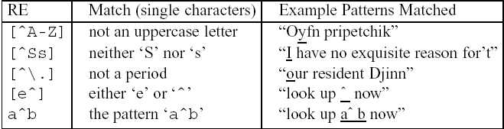

Basic Regular Expression Patterns
caret ^ : negasi
Tanda tanya ? : bisa ada bisa tidak
Titik: . any character

Slide 9
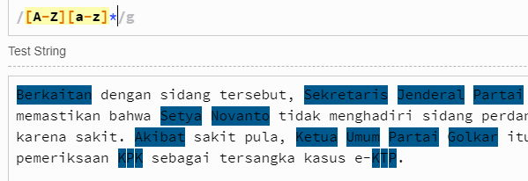
Regex Kata berawal Huruf Kapital
[A-Z][a-z]* : Alfabet huruf besar yang dilanjutkan dengan nol atau banyak huruf kecil

Slide 10
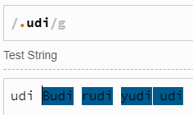
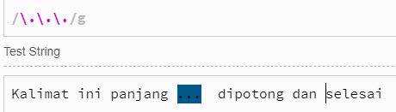
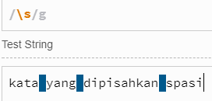
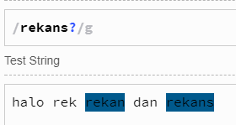
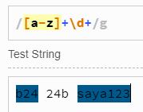
Notasi Regex: Contoh
Metacharacter titik “.” menyatakan karakter apapun (kiri). Gunakanlah backslash ‘\’ untuk metacharacter.

Slide 11
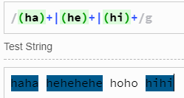
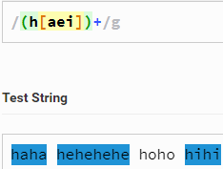
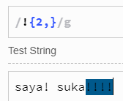
Notasi Regex: Contoh

Slide 12
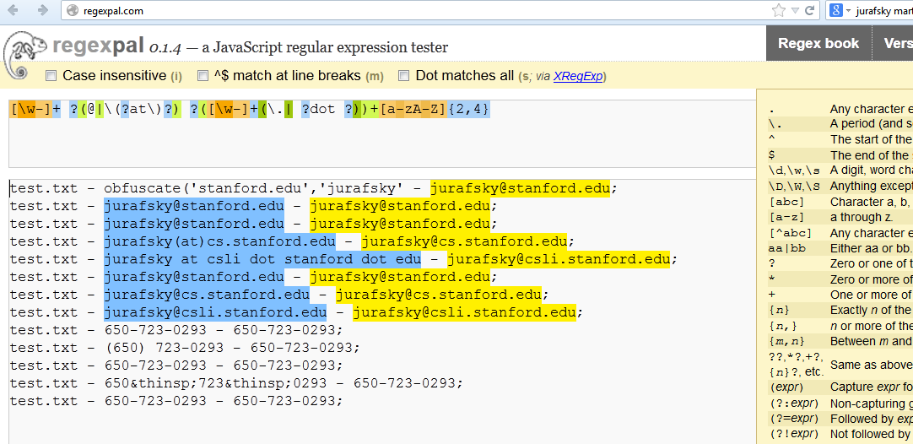
Contoh 3: Regex for Email
Tentukan regexnya untuk semua email yang diwarnai

Slide 13
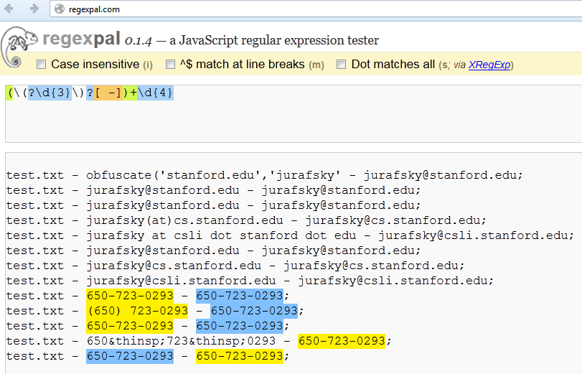
Contoh 4: Regex for Phone Number

Slide 14
Knowledge check Regex
Pelajarilah modul regex: https://docs.google.com/document/d/1ls6h1A6m-Zhzw6e5eriwMNUAG0D1iwL-eVmVMS2XQoc/edit?usp=sharing
Kerjakanlah Latihan 1-3 secara mandiri (tidak dikumpulkan).
Untuk Latihan 4, gunakanlah https://www.regexpal.com/ (tidak dikumpulkan)

Slide 15
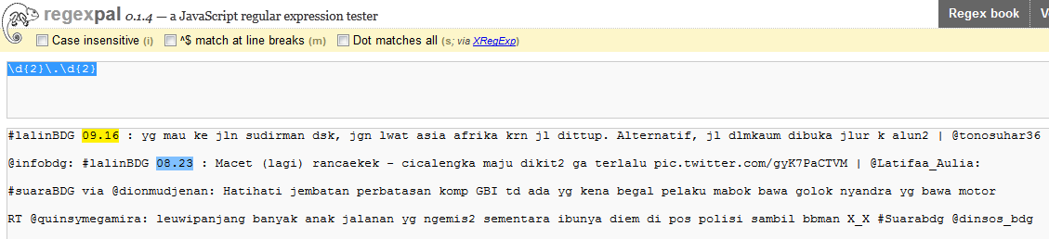
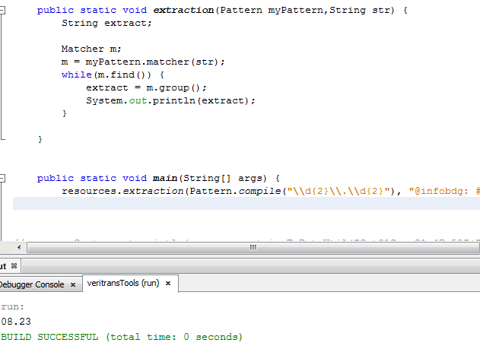
Regex di Java

Slide 16
Regex using Python
re.compile(pattern, flags=0)
Compile a regular expression pattern into a regular expression object, which can be used for matching using its match(), search() and other methods, described below.
Pattern.search(string[, pos[, endpos]])
Scan through string looking for the first location where this regular expression produces a match, and return a corresponding match object. Return None if no position in the string matches the pattern; note that this is different from finding a zero-length match at some point in the string.
The optional second parameter pos gives an index in the string where the search is to start; it defaults to 0.
The optional parameter endpos limits how far the string will be searched;
https://docs.python.org/3/library/re.html

Slide 17
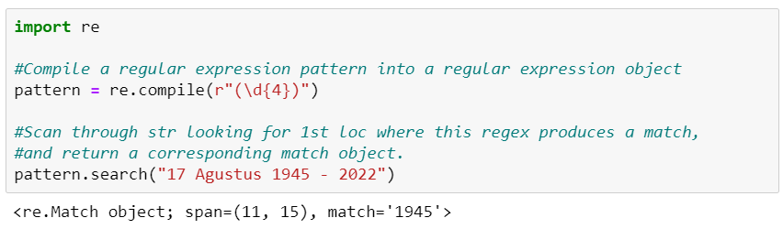
Regex using Python
\d{4}: digit characters exactly 4 characters

Slide 18
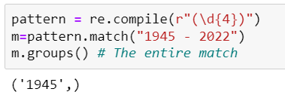
Regex using Python
Pattern.match(string[, pos[, endpos]])
If zero or more characters at the beginning of str match this regular expression, return a corresponding match object. Return None if the string does not match the pattern; note that this is different from a zero-length match.

Slide 19
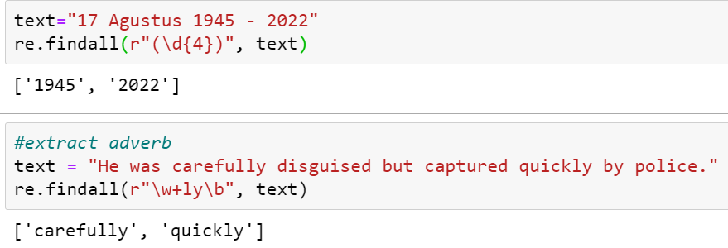
Regex using Python
re.findall(pattern, string, flags=0)
Return all non-overlapping matches of pattern in string, as a list of strings or tuples. The string is scanned left-to-right, and matches are returned in the order found. Empty matches are included in the result.

Slide 20
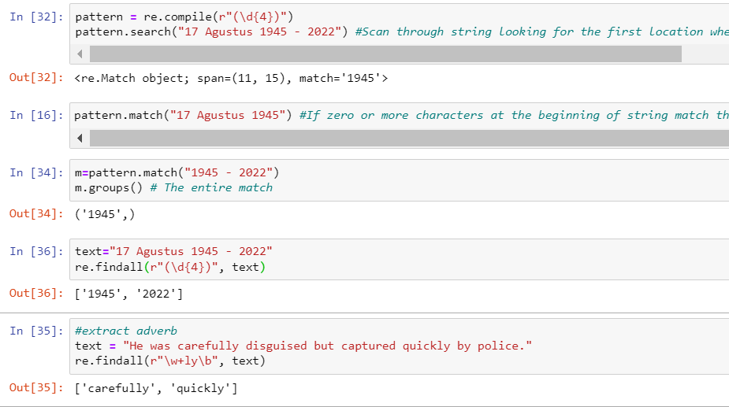
Regex using Python
https://docs.python.org/3/library/re.html
Baca: https://www.guru99.com/python-regular-expressions-complete-tutorial.html

Slide 21
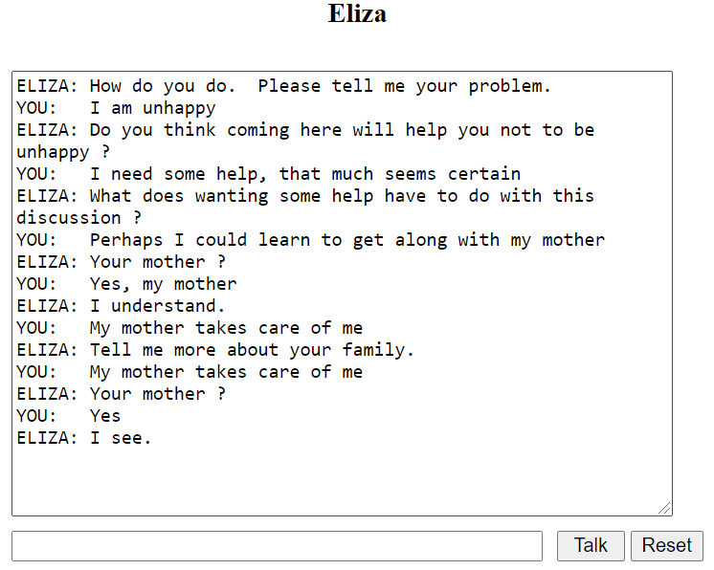
Eliza, simple pattern-based chatbot
ELIZA uses pattern matching to recognize phrases like “I need X” and translate them into suitable outputs like
“What does wanting X have to do with this discussion ?”
“What would it mean to you if you got X?”.
https://www.masswerk.at/elizabot/
http://psych.fullerton.edu/mbirnbaum/psych101/eliza.htm
Weizenbaum, J. (1966). ELIZA—a computer program for the study of natural language communication between man and machine. Communications of the ACM, 9(1), 36-45.

Slide 22
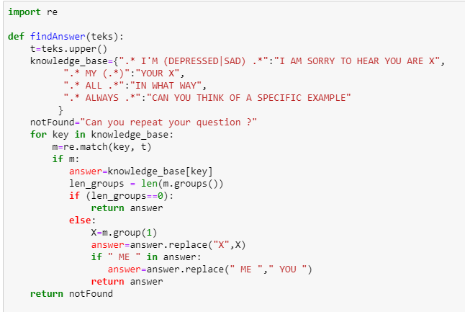
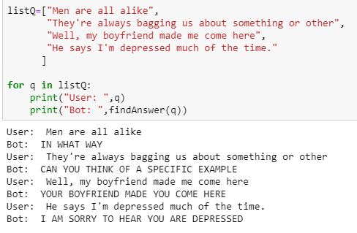
Eliza-like Chatbot using Regex

