Slide 1
Route/Path Planning

Slide 2
Referensi
Materi kuliah IF3170 Inteligensi Buatan Teknik Informatika ITB, Course Website:
  http://kuliah.itb.ac.id → STEI → Teknik Informatika → IF3170
Stuart J Russell & Peter Norvig, Artificial Intelligence: A Modern Approach, 3rd Edition, Prentice-Hall International, Inc, 2010, Textbook
Site: http://aima.cs.berkeley.edu/ (2nd edition)
Free online course materials | MIT OpenCourseWare Website:
Site: http://ocw.mit.edu/courses/electrical-engineering-and-computer-science/
Lecture Notes in Informed Heuristic Search, ICS 271 Fall 2008, http://www.ics.uci.edu/~dechter/courses/ics-271/fall-08/lecture-notes/4.InformedHeuristicSearch.ppt

Slide 3

Route Planning

Slide 4
Search
Source: Russell’s book
O
71
151
F
S
99
Z
75
211
A
140
80
R
B
97
P
120
118
101
D
75
T
M
146
138
111
L
70
C
S: set of cities
i.s: A (Arad)
g.s: B (Bucharest)
Goal test: s = B ?
Path cost: time ~ distance

Slide 5
Uninformed Search

Slide 6

Breadth-First Search (BFS)
Treat agenda as a queue (FIFO)
O
Z
71
151
S
F
99
75
211
A
80
140
R
97
P
B
120
101
118
Simpul-E | Simpul Hidup
A | Z_{A},S_{A},T_{A}
Z_{A} | S_{A},T_{A},O_{AZ}
S_{A} | T_{A},O_{AZ},O_{AS},F_{AS},R_{AS}
T_{A} | O_{AZ},O_{AS},F_{AS},R_{AS},L_{AT}
O_{AZ} | O_{AS},F_{AS},R_{AS},L_{AT}
O_{AS} | F_{AS},R_{AS},L_{AT}
F_{AS} | R_{AS},L_{AT},B_{ASF}
R_{AS} | L_{AT},B_{ASF},D_{ASR},C_{ASR},P_{ASR}
L_{AT} | B_{ASF},D_{ASR},C_{ASR},P_{ASR},M_{ATL}
B_{ASF} | Solusi ketemu
D
75
138
T
70
M
146
111
L
C
Path: A→ S → F → B, Path-cost = 450

Slide 7
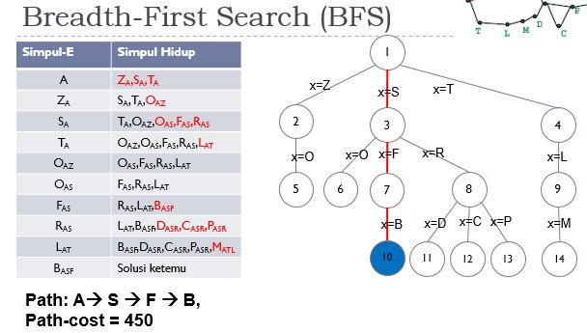

Slide 8
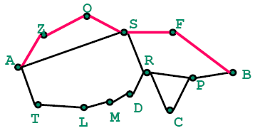
Depth-First Search (DFS)
Treat agenda as a stack (LIFO)
O
Z
71
151
S
F
99
75
211
A
80
140
R
97
P
B
120
118
101
D
75
T
70
M
146
138
111
L
C
Simpul-E | Simpul Hidup
A | Z_{A},S_{A},T_{A}
Z_{A} | O_{AZ}, S_{A},T_{A}
O_{AZ} | S_{AZO},S_{A},T_{A}
S_{AZO} | F_{AZOS}, R_{AZOS},S_{A},T_{A}
F_{AZOS} | B_{AZOSF}, R_{AZOS},S_{A},T_{A}
B_{AZOSF} | Solusi ketemu
Path: A→ Z → O → S → F → B
Path-cost = 607

Slide 9
IDS
Z
71
O
151
S
F
99
75
211
A
80
140
R
97
P
B
120
118
101
D
75
T
70
M
146
138
111
L
C
Depth=0: A: cutoff
Depth=1: A → Z_{A},S_{A},T_{A} → Z_{A}: cutoff, S_{A}: cutoff, T_{A}: cutoff
Depth=2: A → Z_{A},S_{A},T_{A} → O_{AZ}, S_{A},T_{A} → O_{AZ} : cutoff → F_{AS}, R_{AS},T_{A} → F_{AS} : cutoff → R_{AS} : cutoff → L_{AT} → L_{AT} : cutoff
Depth=3: A → Z_{A},S_{A},T_{A} → O_{AZ}, S_{A},T_{A} → S_{AZO},S_{A},T_{A} → S_{AZO}: cutoff → F_{AS}, R_{AS},T_{A} → B_{ASF}, R_{AS},T_{A} → B_{ASF}
Stop: B=goal, path: A→ S → F → B, path-cost = 450

Slide 10
Uniform Cost Search (UCS)
Simpul-E | Simpul Hidup
A | Z_{A-75}, T_{A-118,} S_{A-140}
Z_{A-75} | T_{A-118}, S_{A-140},O_{AZ-146}
T_{A-118} | S_{A-140},O_{AZ-146},L_{AT-229}
S_{A-140} | O_{AZ-146},R_{AS-220}, L_{AT-229},F_{AS-239},O_{AS-291}
O_{AZ-146} | R_{AS-220}, L_{AT-229}, F_{AS-239},O_{AS-291}
R_{AS-220} | L_{AT-229}, F_{AS-239},O_{AS-291}, P_{ASR-317},D_{ASR-340},C_{ASR-366}
L_{AT-229} | F_{AS-239},O_{AS-291},M_{ATL-299}, P_{ASR-317},D_{ASR-340},C_{ASR-366}
F_{AS-239} | O_{AS-291},M_{ATL-299}, P_{ASR-317},D_{ASR-340},C_{ASR-366,} B_{ASF-450}
O_{AS-291} | M_{ATL-299}, P_{ASR-317},D_{ASR-340},C_{ASR-366,} B_{ASF-450}
M_{ATL-299} | P_{ASR-317},D_{ASR-340},D_{ATLM-364},C_{ASR-366,} B_{ASF-450}
P_{ASR-317} | D_{ASR-340},D_{ATLM-364},C_{ASR-366,} B_{ASRP-418}, C_{ASRP-455,} B_{ASF-450}
D_{ASR-340} | D_{ATLM-364},C_{ASR-366,} B_{ASRP-418}, C_{ASRP-455,} B_{ASF-450}
D_{ATLM-364} | C_{ASR-366,} B_{ASRP-418}, C_{ASRP-455,} B_{ASF-450}
C_{ASR-366} | B_{ASRP-418}, C_{ASRP-455,} B_{ASF-450}
B_{ASRP-418} | Solusi ketemu
BFS & IDS find path with fewest steps
If steps ≠ cost, this is not relevant (to optimal solution)
How can we find the shortest path (measured by sum of distances along path)?
Z
71
O
151
S
99
F
75
211
A
140
80
R
97
P
B
120
118
101
D
M
75
146
138
T
111
L
70
C
Path: A→ S → R → P → B
Path-cost = 418

Slide 11
Informed Search

Slide 12
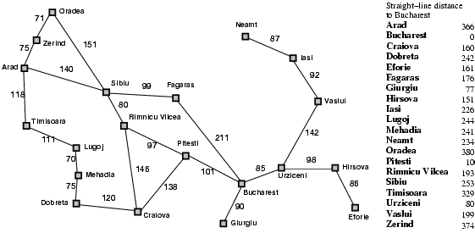
Greedy Best-First Search
Idea: use an evaluation function f(n) for each node
  f(n) = h(n) → estimates of cost from n to goal
  e.g., h_{SLD}(n) = straight-line distance from n to Bucharest
Greedy best-first search expands the node that appears to be closest to goal
Romania with step costs in km

Slide 13

Greedy best-first search example

Slide 14
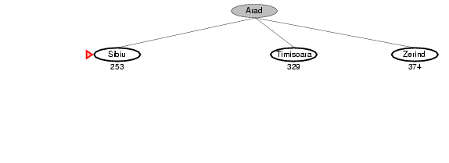
Greedy best-first search example

Slide 15
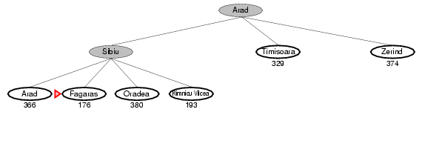
Greedy best-first search example

Slide 16
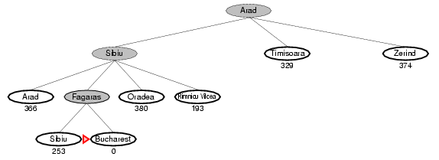
Greedy best-first search example

Slide 17
Problems with Greedy Best First Search
Not complete
Can we incorporate heuristics in systematic search?

Slide 18
Heuristic Search
Heuristic estimates value of a node
  promise of a node
  difficulty of solving the subproblem
  quality of solution represented by node
  the amount of information gained
f(n)- heuristic evaluation function.
  depends on n, goal, search so far, domain

Slide 19
A* Search
Idea: avoid expanding paths that are already expensive
Evaluation function f(n) = g(n) + h(n)
g(n) = cost so far to reach n
h(n) = estimated cost from n to goal
f(n) = estimated total cost of path through n to goal

Slide 20

A* search example

Slide 21
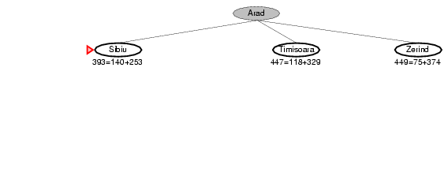
A* search example

Slide 22
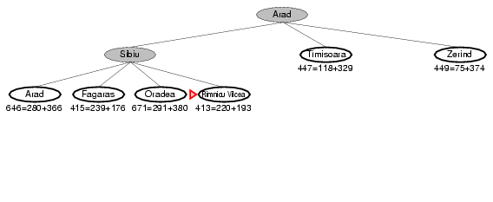
A* search example

Slide 23
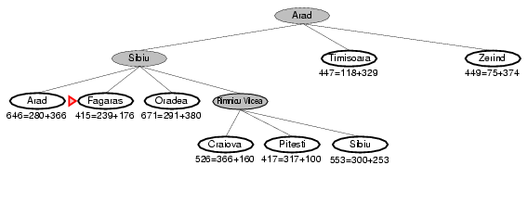
A* search example

Slide 24
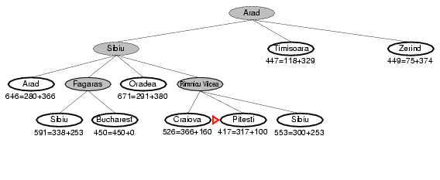
A* search example

Slide 25
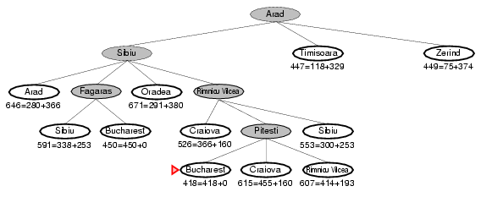
A* search example

Slide 26
A* Special
Goal: find a minimum sum-cost path
Notation:
  c(n,n’) - cost of arc (n,n’)
  g(n) = cost of current path from start to node n in the search tree.
  h(n) = estimate of the cheapest cost of a path from n to a goal.
  Special evaluation function: f = g+h
f(n) estimates the cheapest cost solution path that goes through n.
  h*(n) is the true cheapest cost from n to a goal.
  g*(n) is the true shortest path from the start s, to n.
If the heuristic function, h always underestimate the true cost (h(n) is smaller than h*(n)), then A* is guaranteed to find an optimal solution → admissible; and also has to be consistent

Slide 27
Properties of A*
Complete? Yes, unless there are infinitely many nodes with f ≤ f(G)
Time? Exponential: O(b^{m})
Space? Keep all the nodes in memory: O(b^{m})
Optimal? Yes

Slide 28
Branch-and-Bound vs A*
As in A*, look for a bound which is guaranteed lower than the true cost
Search the branching tree in any way you like
  e.g. depth first (no guarantee), best first
Cut off search if cost + bound > best solution found
If heuristic is cost + bound, search = best first
  then BnB = A*
Bounds often much more sophisticated
  e.g. using mathematical programming optimisations

Slide 29
Admissible heuristics
A heuristic h(n) is admissible if for every node n, h(n) ≤ h*(n), where h*(n) is the true cost to reach the goal state from n.
An admissible heuristic never overestimates the cost to reach the goal, i.e., it is optimistic
Example: h_{SLD}(n) (never overestimates the actual road distance)
Theorem: If h(n) is admissible, A* using TREE-SEARCH is optimal

Slide 30
Admissibility
What must be true about h for A* to find optimal path?
A* finds optimal path if h is admissable; h is admissible when it never overestimates.
In this example, h is not admissible.
In route finding problems, straight-line distance to goal is admissible heuristic.
x
2
73
y
h=100
h=1
1
1
h=0
h=0
g(X)+h(X)=2+100=102
G(Y)+h(Y)=73+1=74
Optimal path is not found!
Because we choose Y, rather than X which is in the optimal path.

Slide 31
Contoh Soal UAS Sem 2 2014/2015
Dalam permainan video game, adakalanya entitas bergerak dalam video game perlu berpindah dari satu posisi ke posisi lain. Seringkali proses perpindahan perlu mengutamakan jalur terdekat atau biaya minimal karena berhubungan dengan poin yang diperoleh. Gambar di bawah ini menunjukkan contoh jalur yang mungkin dilewati oleh entitas bergerak dalam suatu video game. Suatu entitas akan berpindah dari posisi titik A menuju ke posisi titik F. Jika diperlukan informasi heuristik, nilai heuristik dari suatu simpul adalah banyaknya busur minimal yang menghubungkan titik tersebut ke titik tujuan.

Slide 32
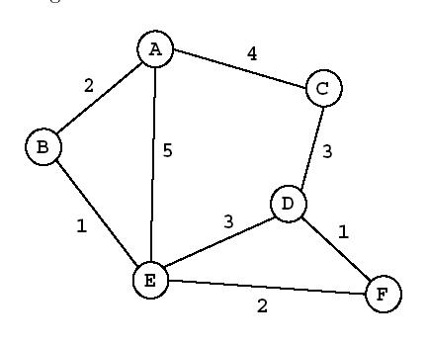
Contoh Soal UAS Sem 2 2014/2015 (2)
Pencarian solusi dengan:
UCS
Greedy Best First
A Star
Untuk masing-masing pendekatan tuliskan:
Formula
Iterasi
  Simpul ekspan
  Simpul hidup & nilai f(n)
Urut abjad, simpul ekspan tidak mengulang, tidak membentuk sirkuit, berhenti saat satu solusi ditemukan

Slide 33
Solusi:

Slide 36
Selamat Belajar

