Slide 1
IF 3280 Socio-Informatika & Profesionalisme: Sustainabilitas (Sustainability)
Semester Genap 2016/2017
K1: Rinaldi Munir
K2:Ayu Purwarianti
K3: Dessi Puji Lestari
Sekolah Teknik Elektro & Informatika

Slide 2
Tujuan Perkuliahan
Memahami apa yang dimaksud sustainabilitas dalam dunia IT/ICT dan green software
Memahami pentingnya membangun perangkat lunak atau sistem IT yang “hijau”

Slide 3
Konten
Sustainabilitas secara umum
Sustainabilitas di dunia IT/ICT

Slide 4
1. Sustainabilitas

Slide 5
Motivasi
Konsumsi energi oleh data centre di dunia naik dari 58 TW di thn 2000 ke 123 TW di 2005
Tingginya pengeluaran dalam membeli tinta printer karena laporan yg digenerate software memiliki warna background dibanding dgn warna putih

Slide 6
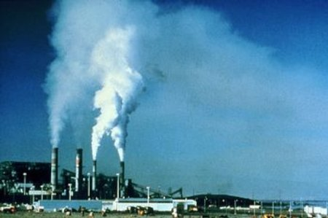
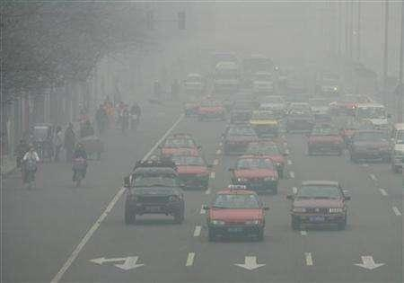
Yes, engineers are part of the problem.
Notes:
Engineers design power plants and cars, both sources of air pollution.

Slide 7
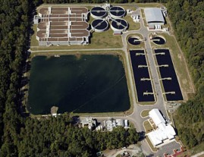
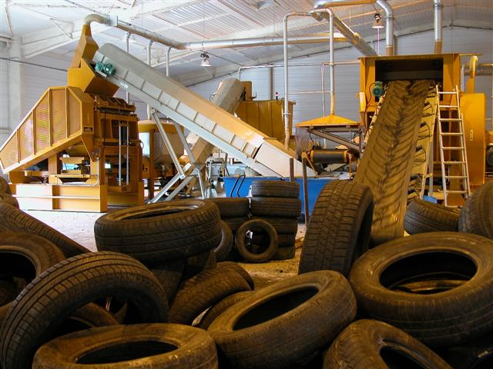
We’re also an integral part of the solution.
Notes:
Top left: Wastewater treatment plant (designed by an environmental engineer).
Top right: Biofilter for air pollution control (designed by an environmental engineer)
Bottom: Waste tires, which can be recycled into asphalt or shredded and reused to stabilize slopes. The recycling and shredding equipment would likely be designed by engineers, as would the roadways and slope embankments where the recycled/reused tires would be used.

Slide 8
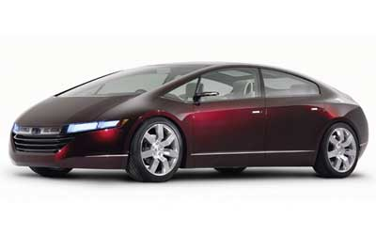
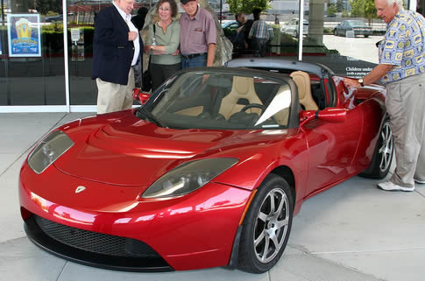
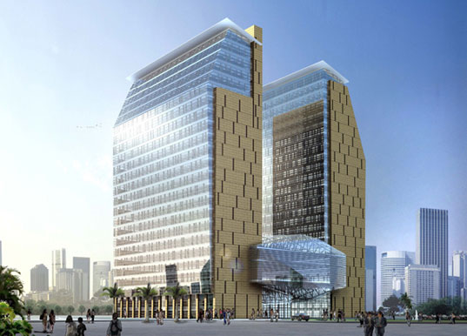
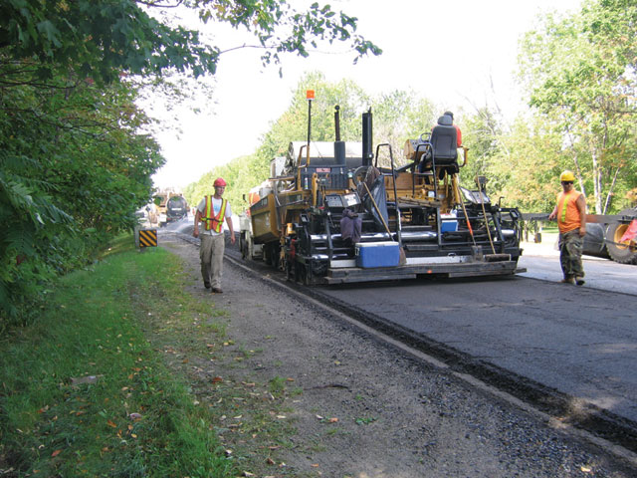
We’re also an integral part of the solution.
Notes:
Top left: Tesla Electric Car (100% electric)
245 miles on a charge
0 to 60 in 3.7 seconds
Manufacturer’s suggested retail price is $109,000
Top right: Honda FCX Fuel Cell Vehicle concept car
Bottom left: Roadway using asphalt with recycled content
Bottom right: The new headquarters of Dubaitech in Dubai is set to be one of the world’s largest green buildings. The LEED certified 22-story headquarters and laboratory buildings will be home to the center of excellence for biotechnology education and research, with two connected buildings oriented to maximize day-lighting and views while minimizing solar gain. It will also integrate a 500,000 sq ft animal reserve for indigenous conservation and wildlife protection.The design comes form design firm CUH2A, and is scheduled for completion in 2009.

Slide 9
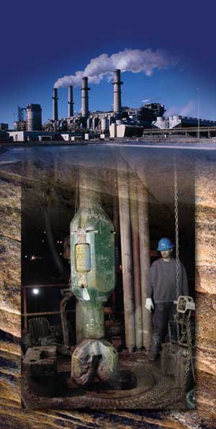
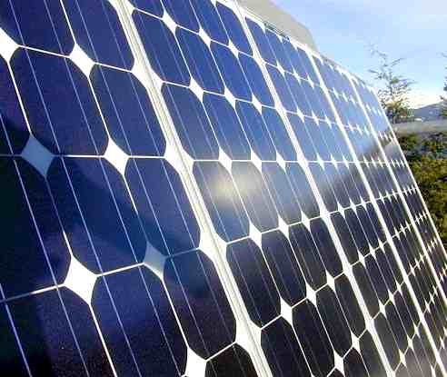
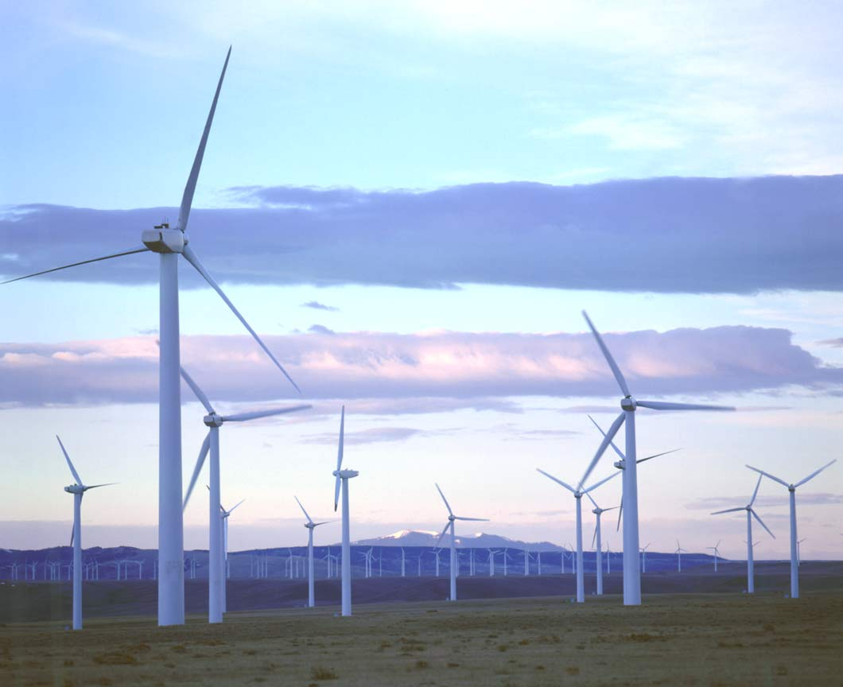
We’re also an integral part of the solution.
Notes:
Left to right:
Solar power cells (materials scientists/engineers and electrical engineers work on these systems)
Coal-fired power plant with carbon capture and underground sequestration/storage (a variety of engineers would be involved with such systems, including likely environmental, geological, mechanical, and electrical).
Wind turbines (designed by mechanical engineers)

Slide 10
Definisi
Sustainability :
“Meeting the needs of the present without compromising the ability of future generations to meet their own needs“ (United Nations)
Sustainabilitas dalam pembangunan:
Pembangunan yang memenuhi kebutuhan manusia tanpa membahayakan generasi yang akan datang.

Slide 11
Praktisi Sustainabilitas
Selalu memperhatikan dampak dari setiap keputusan yang diambil terhadap lingkungan sosial dan budaya
pemilihan kebijakan organisasi
tindakan ekonomi
konsumsi energy
dll

Slide 12
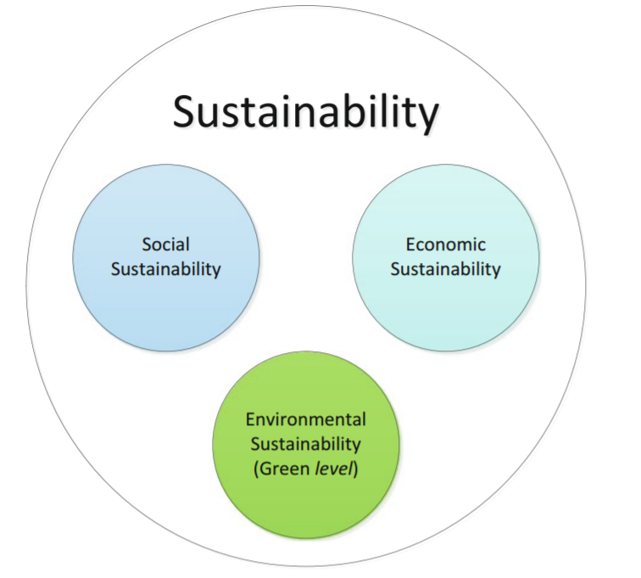
Elemen Sustainabilitas
World Commission on Environment and Development, 1987
Notes:
The three interlinked elements in the Bruntland Commission’s sustainable development equation are environment, economy, and society.
‘Environmental sustainability ensures that the environment is able to replenish itself at a faster rate than it is destroyed by human actions. For instance, the use of recycled material for IT hardware production helps to conserve natural resources. – Social development is concerned about creating a sustainable society which includes social justice or reducing poverty. In general all actions that promote social equity and ethical consumerism.
The economic pillar ensures that our economic growth maintains a healthy balance with our ecosystem; it integrates environmental and social concerns into business’

Slide 13
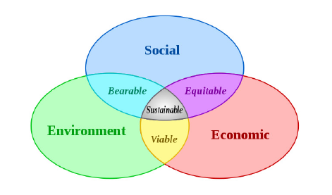
Triple P concept (People, Planet, Profit)
People: Fair practices for all people and does not exploit interest of separate parties based on money, status or growth.
Planet: Management of renewable and non renewable resources while reducing waste.
Profit: Financial benefit enjoyed by the majority of society.

Slide 14
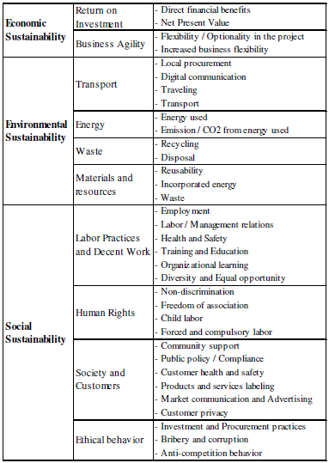

Slide 15
Gap Institusi dalam Pembangunan yang berkelanjutan
Pengambilan keputusan yang tidak terintegrasi
Mandat terbatas
Hukum yang rigid
Kurangnya komunikasi dan koordinasi
Kurangnya akuntabilitas
Tidak ada lembaga yang mengawasi dampak dari aksi yang dilakukan oleh sebuah organisasi terhadap lingkungan

Slide 16
Solusi Sustainabilitas
Penggunaan material yang dapat didaur ulang
Pola hidup: 3 R (Reuse, Reduce, Recycle)
Penggunaan energi yang aman dan reliabel
Konservasi dan penggunaan energi yang dapat diperbarui.
Pola hidup sehat
Komunikasi dan koordinasi
Pengembangan intelektual dan spiritual.
Memperhatikan dampak global dari setiap aksi yang dilakukan

Slide 17
Prinsip Dampak Global menurut PBB
Human Rights / Hak Manusia
Labor / Buruh
Environment / Lingkungan
Anti-Corruption /Anti-korupsi

Slide 18
1. Hak Manusia

Slide 19
2. Perburuhan

Slide 20
3. Lingkungan

Slide 21
4. Anti Korupsi

Slide 22
Traditional Engineering Design Criteria:
Function
Cost
Safety
Sustainable Engineering Design Criteria:
The above plus:
Impact on people (society)
Impact on the planet (environment)

Slide 23
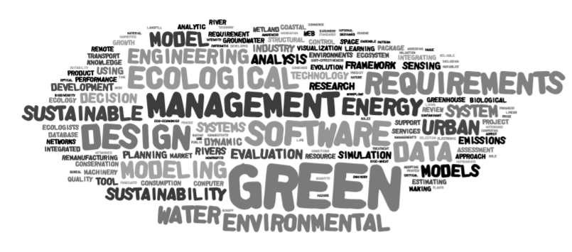
2. Sustainabilitas di Dunia IT/ICT

Slide 24
Permasalahan
Sektor ICT menyumbang:
sekitar 2% emisi global karbondioksida
sekitar 8% penggunaan listrik Uni Eropa
Konsumsi listrik sektor ICT diperkirakan akan meningkat hampir 60% dari tahun 2007 ke tahun 2020

Slide 25
Emisi Karbondioksida Sektor ICT

Slide 26
Trend Sustainabilitas di Sektor IT
Sustainability menjadi semakin penting
Sebuah bisnis yang gagal dalam pembangunan berkelanjutan (sustainabilitas) banyak menerima kritik publik dan kehilangan legitimasi pasar
Menurut survei IBM global (2008):
47% organisasi di bidang ICT mulai menerapkan konsep “strategic sustainability” yaitu mempertimbangkan:
Keberlanjutan
Menjadikan pembangunan s/w berkelanjutan sebagai sumber baru inovasi
Pemotongan biaya
Keberlanjutan sebagai keunggulan kompetitif.

Slide 27
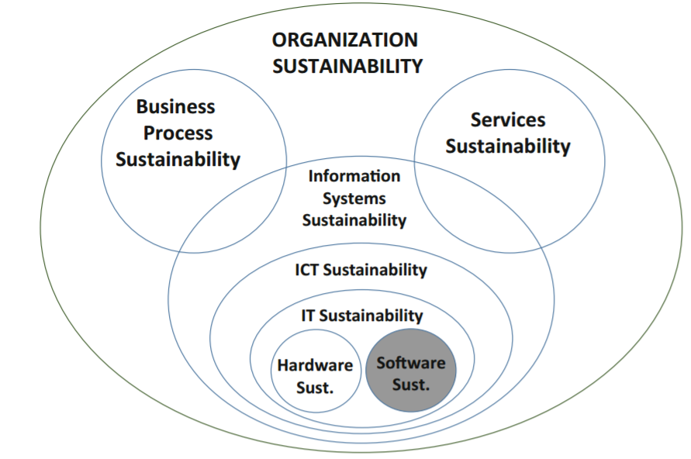
Terminologi dan Lingkup
Sustainability in IT (Green or Greening ICT/IT/Software):
The initiatives that foster respect for the environment by means of ICT, IT, software, etc.

Slide 28
IS Sustainability
Sustainability in IS must take into account aspects such as:
efficiency systems
forecasting
reporting and awareness
energy-efficient home computing
behaviour modification

Slide 29
ICT/IT Sustainability
Aligning all ICT processes and practices with the core principles of sustainability, which are to reduce, reuse and recycle
Finding innovative ways to use ICT in business processes to deliver sustainability benefits across the enterprise and beyond

Slide 30
Software Sustainability
Direct and indirect consumption of natural resources, which arise out of deployment and utilization, are monitored, continuously measured, evaluated and optimized already in the development process
Appropriation and utilization aftermath can be continuously evaluated and optimized
Development and production processes cyclically evaluate and minimize their direct and indirect consumption of natural resources and energy

Slide 31
Software Engineering Sustainability
Sustainable software engineering aims to create reliable, long-lasting software that meets the needs of users while reducing environmental impacts
its goal is to create better software so we will not have to compromise future generations’ opportunities
5 Dimensions of sustainability in SE:
Individual
Social
Economic
Environmental
Technical

Slide 32
1. Individual sustainability
Maintenance of the private good of individual human capital:
Health, education, skills, knowledge, leadership and access to services constitute human capital
‘How can software be created and maintained in a way that enables developers to be satisfied with their job over a long period of time?’

Slide 33
2. Social Sustainability
Maintaining social capital (investments and services) and preserving the solidarity of societal communities.
‘What effects do software systems have on society (e.g. communication, interaction, government)?’

Slide 34
3. Economic Sustainability
This aims to maintain assets.
Assets include not only capital but also added value.
‘How can software systems be created so that the stakeholders’ long-term investments are as safe as possible from economic risks?’

Slide 35
4. Environmental Sustainability
This seeks to improve human welfare by protecting natural resources such as water, land, air, minerals and ecosystem services;
Environment includes:
the sources of raw materials used for human needs
sink capacities recycling human wastes
‘How does software affect the environment during, inter alia, development and maintenance?’

Slide 36
5. Technical Sustainability
Technical sustainability has the central objective of:
long-time usage of systems
their adequate evolution with changing surrounding conditions and respective requirements
How can software be created so that it can easily adapt to future change?

Slide 37
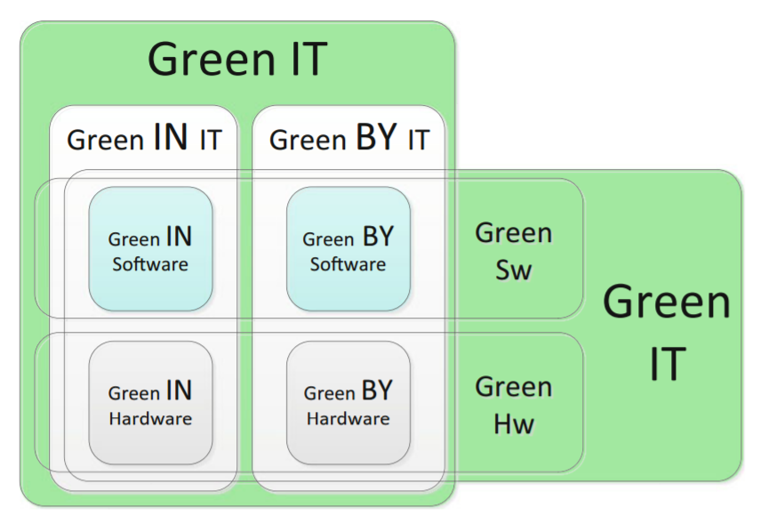
From Sustainability to Greenability
Notes:
Green for IT (Green in IT), projects aiming to reduce the environmental impact of IT, also known as Green IT 1.0. For example, 10 GbE (10 gigabit per second Ethernet), clean energy to power data centres, hardware virtualisation, cloud computing services (i.e. software as a service (SaaS), Web services, infrastructure as a service, developing platform as a service), data centre outsourcing and co-location services, IT asset disposal and recycling services, IT energy measurement, localised cooling, managed printing services, PC power management software, storage capacity optimisation, thin clients (i.e. low-cost terminals limited to user interface (UI) processing, data processing being run on the server) 2. IT for Green (Green by IT), projects aiming to reduce the environmental impact of operations using IT, also known as Green IT 2.0. For example, process automation, remote collaboration, TelePresence, and resource usage management (energy, water, paper, CO2), for example, Project 2 degrees

Slide 38
Green Software
An application that produces as little waste as possible during its development and operation.
Must fulfil three high-level requirements:
The required software engineering processes of software development, maintenance and disposal must save resources and reduce waste.
Software execution must save resources and reduce waste.
Software must support sustainable development.

Slide 39
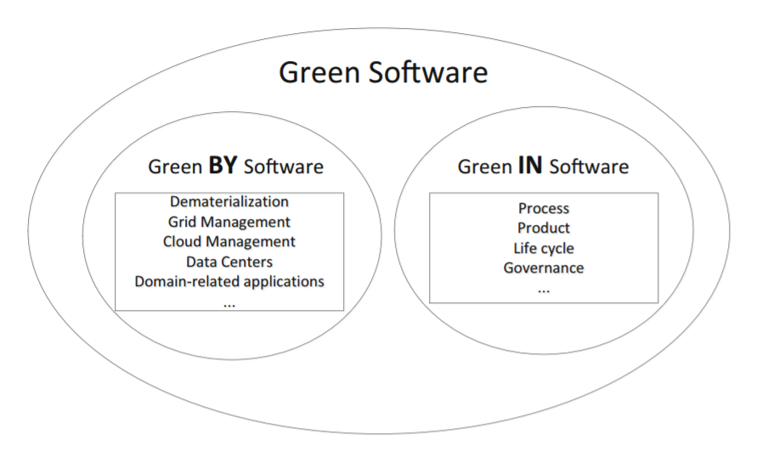
Green Software Categories
Software that is greener (consumes less energy to run)
Embedded software that assists other things in going green (smart operations)
Sustainability-reporting software (or carbon management software)
Software for understanding climate change, assessing its implications and forming suitable policy responses

Slide 40
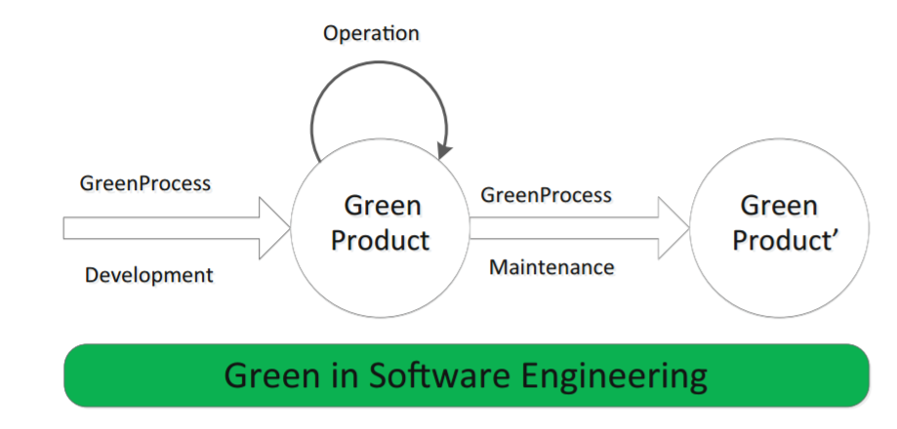
Green in Software Engineering

Slide 41
Referensi
Coral Calero and Mario Piattini (2015): Introduction to Green in Software Engineering, Chapter 1

Slide 42
Sustainabilitas dalam dunia IT: Tugas Individu
Lakukan eksplorasi dampak hal-hal berikut terhadap lingkungan global dan sosial:
Penggunaan komputer dan cara pembuangannya (e-waste)
Pemilihan desain pada area spesifik:
algoritma
sistem operasi
jaringan komputer
basis data
bahasa pemrograman
Interaksi manusia dengan komputer.
Laporan ditulis dalam 5 halaman A4 dan harus mengandung semua elemen di atas.
Dikumpulkan hari Rabu, 5 April 2016 di kelas.

