Slide 1
IF3230 Sistem Paralel dan Terdistribusi paralel programming model: GPU
Achmad Imam Kistijantoro (imam@informatika.org)
Afwarman Manaf (awang@informatika.org)
Februari 2014
Informatika – STEI – ITB

Slide 2
A Common Programming Pattern
akses memori tercepat: shared memory
komputasi pada CUDA:
partisi data menjadi ukuran shared memory yang berada dalam blok
handle setiap data subset dalam satu thread block
load data
komputasi
store data ke global memory

Slide 3
A Common Programming Pattern
CUDA memiliki memori jenis Texture & Constant
terletak pada DRAM milik device (global)
lebih lambat dari shared memory, namun cached
Data pada program
R/O no structure -> constant memory
R/O array structure -> texture memory
R/W shared within block -> shared memory
R/W register spills to local memory
R/W inputs/results -> global memory

Slide 4
CUDA HW: e.g.: GTX 275
terdiri atas 30 Multiprocessor
1 MP: 8 processor (32-bit) dengan SIMD architecture (shared instruction unit)
setiap clock cycle, sebuah MP menjalankan instruksi yang sama pada grup thread yang disebut warp
jumlah thread dalam warp: warp size

Slide 5
setiap thread block dibagi menjadi warp (ukuran 32), dieksekusi oleh 1 MP
1 MP dapat mengeksekusi multiple block pada saat yg sama
shared memory & register di share oleh threads pada concurrent block
mengurangi penggunaan memory per block dan register per thread meningkatkan jumlah block per MP

Slide 6
SM implements zero overhead warp scheduling, any warp ready in SM are eligible for execution
4 clock cycles needed to dispatch the same instruction on all threads in a warp
if one global memory access per 4 instructions, minimal 13 warps are needed to tolerate 200 cycles memory access time

Slide 7
granularity considerations
for matrix multiplication, what are the sizes of the blocks?
8x8: 64 threads/block. 1 SM: 768 threads max, 8 block max. 8x8 requires 12 blocks
16x16: 256 threads/block, requires 3 blocks
32x32: 1024 threads/block: no SM is capable for this

Slide 8
Memory access time
registers: 1 cycle
shared memory: 1 cycle
local memory: DRAM, no cache, slow
global memory: DRAM, no cache, slow
constant memory: DRAM, cached, 1..10..100s cycles
texture memory: DRAM, cached, 1..10..100s cycles

Slide 9
Common Parallel Computing Scenarios
Many parallel threads need to generate a single result
→ Reduce
Many parallel threads need to partition data
→ Split
Many parallel threads produce variable output / thread
→ Compact / Expand

Slide 10
Primordial CUDA Pattern: Blocking
Partition data to operate in well-sized blocks
Small enough to be staged in shared memory
Assign each data partition to a thread block
No different from cache blocking!
Provides several performance benefits
Have enough blocks to keep processors busy
Working in shared memory cuts memory latency dramatically
Likely to have coherent access patterns on load/store to shared memory

Slide 11
Primordial CUDA Pattern: Blocking
Partition data into subsets that fit into shared memory

Slide 12
Primordial CUDA Pattern: Blocking
Handle each data subset with one thread block

Slide 13
Primordial CUDA Pattern: Blocking
Load the subset from global memory to shared memory, using multiple threads to exploit memory-level parallelism

Slide 14
Primordial CUDA Pattern: Blocking
Perform the computation on the subset from shared memory

Slide 15
Primordial CUDA Pattern: Blocking
Copy the result from shared memory back to global memory

Slide 16
Primordial CUDA Pattern: Blocking
All CUDA kernels are built this way
Blocking may not matter for a particular problem, but you’re still forced to think about it
Not all kernels require __shared__ memory
All kernels do require registers
All of the parallel patterns we’ll discuss have CUDA implementations that exploit blocking in some fashion

Slide 17
Reduction
Reduce vector to a single value
Via an associative operator (+, *, min/max, AND/OR, …)
CPU: sequential implementation
for(int i = 0, i < n, ++i) ...
GPU: “tree”-based implementation
3
1
7
0
4
1
6
3
4
7
5
9
11
14
25
Notes:
Common in traditional GPGPU
Ping-pong between render targets, reduce by 1/2 at a time
Completely bandwidth bound using graphics API
All memory writes/reads off-chip, no reuse of intermediate sums
CUDA solves this by exposing on-chip shared memory
Reduce blocks of data in shared memory to save bandwidth

Slide 18
Serial Reduction
// reduction via serial iteration
float sum(float *data, int n)
{
float result = 0;
for(int i = 0; i < n; ++i)
{
result += data[i];
}
return result;
}

Slide 19
Parallel Reduction – Interleaved
Values (in shared memory)
10
1
8
-1
0
-2
3
5
-2
-3
2
7
0
11
0
2
Step 1 Stride 1
Thread IDs
0
1
2
3
4
5
6
7
Values
11
1
7
-1
-2
-2
8
5
-5
-3
9
7
11
11
2
2
Step 2 Stride 2
Thread IDs
0
1
2
3
Values
18
1
7
-1
6
-2
8
5
4
-3
9
7
13
11
2
2
Step 3 Stride 4
Thread IDs
0
1
Values
24
1
7
-1
6
-2
8
5
17
-3
9
7
13
11
2
2
Step 4 Stride 8
Thread IDs
0
Values
41
1
7
-1
6
-2
8
5
17
-3
9
7
13
11
2
2

Slide 20
Parallel Reduction – Contiguous
Values (in shared memory)
10
1
8
-1
0
-2
3
5
-2
-3
2
7
0
11
0
2
Step 1 Stride 8
Thread IDs
0
1
2
3
4
5
6
7
Values
8
-2
10
6
0
9
3
7
-2
-3
2
7
0
11
0
2
Step 2 Stride 4
Thread IDs
0
1
2
3
Values
8
7
13
13
0
9
3
7
-2
-3
2
7
0
11
0
2
Step 3 Stride 2
Thread IDs
0
1
Values
21
20
13
13
0
9
3
7
-2
-3
2
7
0
11
0
2
Step 4 Stride 1
Thread IDs
0
Values
41
20
13
13
0
9
3
7
-2
-3
2
7
0
11
0
2

Slide 21
CUDA Reduction
__global__ void block_sum(float *input,
float *results,
size_t n)
{
extern __shared__ float sdata[];
int i = ..., int tx = threadIdx.x;
// load input into __shared__ memory
float x = 0;
if(i < n)
x = input[i];
sdata[tx] = x;
__syncthreads();

Slide 22
CUDA Reduction
// block-wide reduction in __shared__ mem
for(int offset = blockDim.x / 2;
offset > 0;
offset >>= 1)
{
if(tx < offset)
{
// add a partial sum upstream to our own
sdata[tx] += sdata[tx + offset];
}
__syncthreads();
}

Slide 23
CUDA Reduction
// finally, thread 0 writes the result
if(threadIdx.x == 0)
{
// note that the result is per-block
// not per-thread
results[blockIdx.x] = sdata[0];
}
}

Slide 24
An Aside
// is this barrier divergent?
for(int offset = blockDim.x / 2;
offset > 0;
offset >>= 1)
{
...
__syncthreads();
}

Slide 25
An Aside
// what about this one?
__global__ void do_i_halt(int *input)
{
int i = ...
if(input[i])
{
...
__syncthreads();
}
}
// a divergent barrier
// hangs the machine

Slide 26
CUDA Reduction
// global sum via per-block reductions
float sum(float *d_input, size_t n)
{
size_t block_size = ..., num_blocks = ...;
// allocate per-block partial sums
// plus a final total sum
float *d_sums = 0;
cudaMalloc((void**)&d_sums,
sizeof(float) * (num_blocks + 1));
...

Slide 27
CUDA Reduction
// reduce per-block partial sums
int smem_sz = block_size*sizeof(float);
block_sum<<<num_blocks,block_size,smem_sz>>>
(d_input, d_sums, n);
// reduce partial sums to a total sum
block_sum<<<1,block_size,smem_sz>>>
d_sums, d_sums + num_blocks, num_blocks);
// copy result to host
float result = 0;
cudaMemcpy(&result, d_sums+num_blocks, ...);
return result;
}

Slide 28
Parallel Reduction Complexity
Log(N) parallel steps, each step S does N/2^{S} independent ops
Step Complexity is O(log N)
For N=2^{D}, performs ∑_{S∈[1..D]}2^{D-S} = N-1 operations
Work Complexity is O(N) – It is work-efficient
i.e. does not perform more operations than a sequential algorithm
With P threads physically in parallel (P processors), time complexity is O(N/P + log N)
Compare to O(N) for sequential reduction

Slide 29
Split Operation
Given:array of true and false elements (and payloads)
Return an array with all true elements at the beginning
Examples: sorting, building trees
Flag
T
F
F
T
F
F
T
F
Payload
3
1
7
0
4
1
6
3
T
T
T
F
F
F
F
F
3
0
6
1
7
4
1
3

Slide 30
Variable Output Per Thread: Compact
Remove null elements
Example: collision detection
3
0
7
0
4
1
0
3
3
7
4
1
3

Slide 31
Variable Output Per Thread: General Case
Reserve Variable Storage Per Thread
Example: binning
2
1
0
3
2
A
C
D
G
B
E
H
F

Slide 32
Split, Compact, Expand
Each thread must answer a simple question:
“Where do I write my output?”
The answer depends on what other threads write!
Scan provides an efficient parallel answer

Slide 33
Scan (a.k.a. Parallel Prefix Sum)
Given an array A = [a₀, a₁, …, a_{n-1}] and a binary associative operator ⊕ with identity I,
scan(A) = [I, a₀, (a₀ ⊕ a₁), …, (a₀ ⊕ a₁ ⊕ … ⊕ a_{n-2})]
Prefix sum: if ⊕ is addition, then scan on the series
returns the series
3 | 1 | 7 | 0 | 4 | 1 | 6 | 3
0 | 3 | 4 | 11 | 11 | 15 | 16 | 22

Slide 34
Applications of Scan
Scan is a simple and useful parallel building block for many parallel algorithms:
Fascinating, since scan is unnecessary in sequential computing!
Radix sort
Quicksort (seg. scan)
String comparison
Lexical analysis
Stream compaction
Run-length encoding
Polynomial evaluation
Solving recurrences
Tree operations
Histograms
Allocation
Etc.

Slide 35
Serial Scan
int input[8] = {3, 1, 7, 0, 4, 1, 6, 3};
int result[8];
int running_sum = 0;
for(int i = 0; i < 8; ++i)
{
result[i] = running_sum;
running_sum += input[i];
}
// result = {0, 3, 4, 11, 11, 15, 16, 22}

Slide 36
A Scan Algorithm – Preview
3
1
7
0
4
1
6
3
Assume array is already in shared memory
See Harris, M., S. Sengupta, and J.D. Owens. “Parallel Prefix Sum (Scan) in CUDA”, GPU Gems 3

Slide 37
A Scan Algorithm – Preview
3
1
7
0
4
1
6
3
Iteration 0, n-1 threads
3
4
8
7
4
5
7
9
Each corresponds to a single thread.
Iterate log(n) times. Each thread adds value stride elements away to its own value

Slide 38
A Scan Algorithm – Preview
3
1
7
0
4
1
6
3
3
4
8
7
4
5
7
9
Iteration 1, n-2 threads
3
4
11
11
12
12
11
14
Each corresponds to a single thread.
Iterate log(n) times. Each thread adds value offset elements away to its own value

Slide 39
A Scan Algorithm – Preview
3
1
7
0
4
1
6
3
3
4
8
7
4
5
7
9
3
4
11
11
12
12
11
14
Iteration i, n-2^{i} threads
3
4
11
11
15
16
22
25
Each corresponds to a single thread.
Iterate log(n) times. Each thread adds value offset elements away to its own value.
Note that this algorithm operates in-place: no need for double buffering

Slide 40
A Scan Algorithm – Preview
3
4
11
11
15
16
22
25
We have an inclusive scan result

Slide 41
A Scan Algorithm – Preview
3
4
11
11
15
16
22
25
?
0
0
3
4
11
11
15
16
22
For an exclusive scan, right-shift through __shared__ memory
Note that the unused final element is also the sum of the entire array
Often called the “carry”
Scan & reduce in one pass

Slide 42
CUDA Block-wise Inclusive Scan
__global__ void inclusive_scan(int *input)
{
extern __shared__ int sdata[];
unsigned int i = ...
// load input into __shared__ memory
int sum = input[i];
sdata[threadIdx.x] = sum;
__syncthreads();
...

Slide 43
CUDA Block-wise Inclusive Scan
for(int o = 1; o < blockDim.x; o <<= 1)
{
if(threadIdx.x >= o)
sum += sdata[threadIdx.x - o];
// wait on reads
__syncthreads();
// write my partial sum
sdata[threadIdx.x] = sum;
// wait on writes
__syncthreads();
}

Slide 44
CUDA Block-wise Inclusive Scan
// we're done!
// each thread writes out its result
result[i] = sdata[threadIdx.x];
}

Slide 45
Results are Local to Each Block
Block 0
Input:
5 5 4 4 5 4 0 0 4 2 5 5 1 3 1 5
Result:
5 10 14 18 23 27 27 27 31 33 38 43 44 47 48 53
Block 1
Input:
1 2 3 0 3 0 2 3 4 4 3 2 2 5 5 0
Result:
1 3 6 6 9 9 11 14 18 22 25 27 29 34 39 39

Slide 46
Results are Local to Each Block
Need to propagate results from each block to all subsequent blocks
2-phase scan
1. Per-block scan & reduce
2. Scan per-block sums
Final update propagates phase 2 data and transforms to exclusive scan result

Slide 47
Summing Up
Patterns like reduce, split, compact, scan, and others let us reason about data parallel problems abstractly
Higher level patterns are built from more fundamental patterns
Scan in particular is fundamental to parallel processing, but unnecessary in a serial world

Slide 48
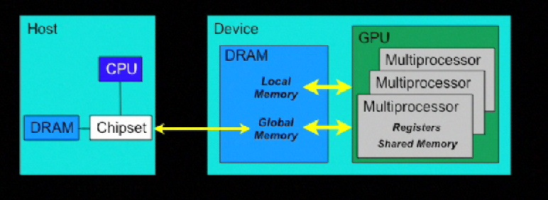
local memory resides on DRAM

Slide 49
Model eksekusi

Slide 50
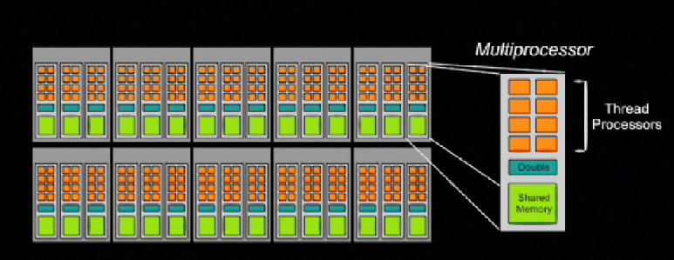
240 thread processors
30 multiprocessors, each contains
8 thread processors
one double precision unit
shared memory

Slide 51
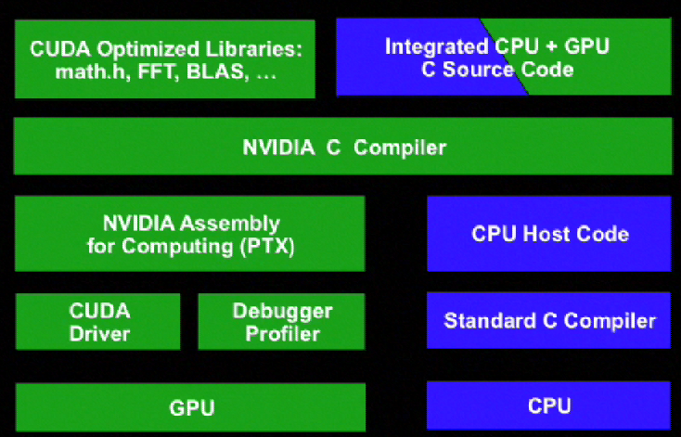
CUDA Programming

Slide 52
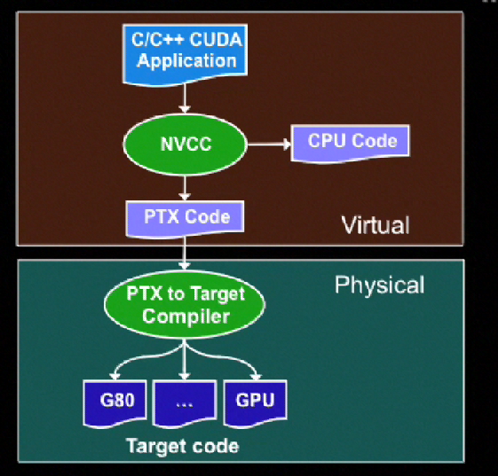
Compiling CUDA code

Slide 53
Executing code on GPU
kernels are C functions:
cannot access host memory
must have void return type
no variable arguments (varargs)
not recursive
no static variables
qualifier: __global__
function arguments are automatically copied from host to device

Slide 54
launching kernels
kernel<<<dG,dB>>>(…)
dG: dimension of grid in blocks (2D)
dB: dimension of block in thread (3D)
dim3 grid, block;
grid.x = 2; grid.y = 4; block.x =8;block.y=16;
kernel<<<grid, block>>>(..)
dim3 grid(2,4); dim3 block(8,16);
kernel<<<grid, block>>>(..)

Slide 55
host synchronization
all kernel launches are asynchronous
cudaMemcpy() is synchronous
cudaThreadSynchronize() blocks until all previous CUDA calls complete

Slide 56
built-in vector types
[u]char[1..4], [u]short[1..4], [u]int[1..4], [u]long[1..4], [u]float[1..4] ,[u]double[1..4]
structures are accessed as x, y, z, w
uint4 param;

Slide 57
Spesifikasi H/W
The maximum number of threads per block is 512;
The maximum sizes of the x-, y-, and z-dimension of a thread block are 512, 512, and 64, respectively;
The maximum size of each dimension of a grid of thread blocks is 65535;
The warp size is 32 threads;
The number of registers per multiprocessor is 16384;
The amount of shared memory available per multiprocessor is 16 KB organized into 16 banks

Slide 58
The total amount of constant memory is 64 KB;
The total amount of local memory per thread is 16 KB;
The cache working set for constant memory is 8 KB per multiprocessor;
The cache working set for texture memory varies between 6 and 8 KB per
multiprocessor;
The maximum number of active blocks per multiprocessor is 8;

Slide 59
The maximum number of active warps per multiprocessor is 32;
The maximum number of active threads per multiprocessor is 1024;
For a one-dimensional texture reference bound to a CUDA array, the maximum width is 213;
For a one-dimensional texture reference bound to linear memory, the maximum width is 227;

Slide 60
For a two-dimensional texture reference bound to linear memory or a CUDA array, the maximum width is 216 and the maximum height is 215;
For a three-dimensional texture reference bound to a CUDA array, the maximum width is 211, the maximum height is 211, and the maximum depth is 211;
The limit on kernel size is 2 millions of microcode instructions;

Slide 61
Sumber
NVIDIA Cuda Programming Guide 2.3.1

