Slide 1
Kompetisi Fungsi Hash NIST
(SHA-3)
Bahan Kuliah IF3058 Kriptografi

Slide 2
Latar Belakang
Seperti sejarah AES, National Institute of Standards and Technology (NIST) menyelenggarakan kompetisi terbuka untuk mengembangkan fungsi hash yang baru, bernama SHA-3
SHA-3 menjadi komplementer SHA-1 dan SHA-2
Kompetisi diumumkan pada tahun 2007 dan berakhir pada Oktober 2012 dengan memilih pemenang.

Slide 3
Proses Pemilihan
Proses pemilihan terdiri dari 2 putaran dan final
Jumlah submission adalah 64 rancangan fungsi hash.
Putaran pertama (penyisihan): dipilih 51 submission
Putaran kedua (semi final): dipilih 14 submission
Babak final: 5 finalis

Slide 4
Finalis
BLAKE
Grøstl
JH
Keccak
Skein

Slide 5
BLAKE
Designers: Jean-Philippe Aumasson, Luca Henzen, Willi Meier, Raphael C.-W. Phan
Detail: Digest sizes 224, 256, 384 or 512 bits
Rounds 14 or 16

Slide 6
Grøstl
Designers: Praveen Gauravaram, Lars Knudsen, Krystian Matusiewicz, Florian Mendel, Christian Rechberger, Martin Schläffer, and Søren S. Thomsen
Detail: Digest sizes 256 and 512

Slide 7
JH
Designers: Hongjun Wu
Detail: Digest sizes 224, 256, 384, 512

Slide 8
Keccak
Designers: Guido Breton, Joan Daemen, Michaël Peeters and Gilles Van Assche.
Detail: Digest sizes arbitrary

Slide 9
SKEIN
Designers: Bruce Schneier, Stefan Lucks, Niels Ferguson, Doug Whiting, Mihir Bellare, Tadayoshi Kohno, Jon Callas and Jesse Walker.
Detail: Digest sizes arbitrary
Rounds: 72 (256 & 512 block size), 80 (1024 block size)

Slide 10
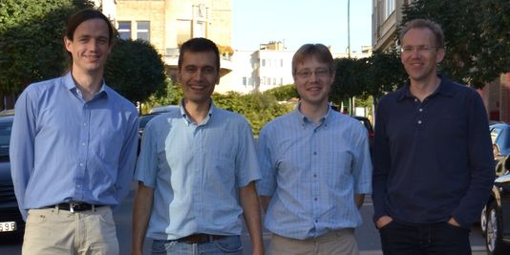
dan pemenangnya adalah…
Keccak
Keccak terpilih sebagai SHA-3
Guido Breton, Joan Daemen, Michaël Peeters and Gilles Van Assche.

Slide 11
Kriteria Penilaian oleh NIST
NIST noted some factors that figured into its selection as it announced the finalists:^{[11]}
Performance: "A couple of algorithms were wounded or eliminated by very large [hardware gate] area requirement – it seemed that the area they required precluded their use in too much of the potential application space.“
Security: "We preferred to be conservative about security, and in some cases did not select algorithms with exceptional performance, largely because something about them made us 'nervous,' even though we knew of no clear attack against the full algorithm.“
Analysis: "NIST eliminated several algorithms because of the extent of their second-round tweaks or because of a relative lack of reported cryptanalysis – either tended to create the suspicion that the design might not yet be fully tested and mature.“
Diversity: The finalists included hashes based on different modes of operation, including the HAIFA and sponge function constructions, and with different internal structures, including ones based on AES, bitslicing, and alternating XOR with addition.

Slide 12
Sekilas Keccak
Nama 'Keccak' berasal dari 'Kecak', tarian Bali.
Keccak berbeda dari finalis SHA3 lainnya dalam hal menggunakan konstruksi 'spons' (sponge construction). Jika desain lainnya bergantung pada 'fungsi kompresi, Keccak menggunakan fungsi non-kompresi untuk menyerap dan kemudian 'memeras' digest singkat.
Ini jelas apakah desain ini lebih baik atau lebih buruk daripada pendekatan yang ada. Tapi itu berbeda. NIST merasa bahwa dalam kasus ini, yang berbeda adalah lebih baik.

Slide 13
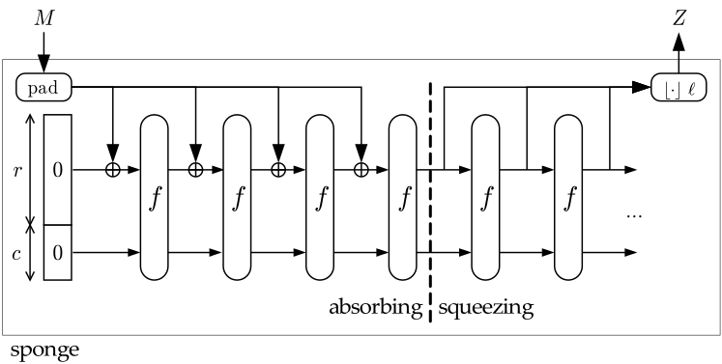
Konstruksi spons

Slide 14
First, the input string is padded with a reversible padding rule and cut into blocks of r bits. Then the b bits of the state are initialized to zero and the sponge construction proceeds in two phases:
(a) In the absorbing phase, the r-bit input blocks are XORed into the first r bits of the state, interleaved with applications of the function f. When all input blocks are processed, the sponge construction switches to the squeezing phase.
(b) In the squeezing phase, the first r bits of the state are returned as output blocks, interleaved with applications of the function f. The number of output blocks is chosen at will by the user.
The last c bits of the state are never directly affected by the input blocks and are never output during the squeezing phase.
Sumber: http://sponge.noekeon.org/

Slide 15
Keccak[r,c](M) {
Initialization and padding
S[x,y] = 0, forall (x,y) in (0…4,0…4)
P = M || 0x01 || 0x00 || … || 0x00
P = P xor (0x00 || … || 0x00 || 0x80)
Absorbing phase
forall block Pi in P
S[x,y] = S[x,y] xor Pi[x+5*y], forall (x,y) such that x+5*y < r/w
S = Keccak-f[r+c](S)
Squeezing phase
Z = empty string
while output is requested
Z = Z || S[x,y], forall (x,y) such that x+5*y < r/w
S = Keccak-f[r+c](S)
return Z
}

Slide 16
Keccak-f[b](A) {
forall i in 0…nr-1
A = Round[b](A, RC[i])
return A
}
Round[b](A,RC) {
θ step
C[x] = A[x,0] xor A[x,1] xor A[x,2] xor A[x,3] xor A[x,4], forall x in 0…4
D[x] = C[x-1] xor rot(C[x+1],1), forall x in 0…4
A[x,y] = A[x,y] xor D[x], forall (x,y) in (0…4,0…4)
ρ and π steps
B[y,2*x+3*y] = rot(A[x,y], r[x,y]), forall (x,y) in (0…4,0…4)
χ step
A[x,y] = B[x,y] xor ((not B[x+1,y]) and B[x+2,y]), forall (x,y) in (0…4,0…4)
ι step
A[0,0] = A[0,0] xor RC
return A
}

Slide 17
Spesifikasi Keccak (termasuk source code) dapat dilihat di: http://keccak.noekeon.org/specs_summary.html

