Slide 1

Pengantar Interpretasi dan Pengolahan Citra (Bagian 2 – Update 2022)
IF4073 Interpretasi dan Pengolahan Citra
Oleh: Rinaldi Munir
Program Studi Teknik Informatika
Sekolah Teknik Elektro dan Informatika
Institut Teknologi Bandung
2022

Slide 2
Key Stages in Digital Image Processing
Sumber: Yacov Hel-Or, Image Processing, Spring 2010
Image Restoration
Morphological Processing
Image Enhancement
Segmentation
Image Acquisition
Object Recognition
Representation & Description
Problem Domain
Colour Image Processing
Image Compression

Slide 3
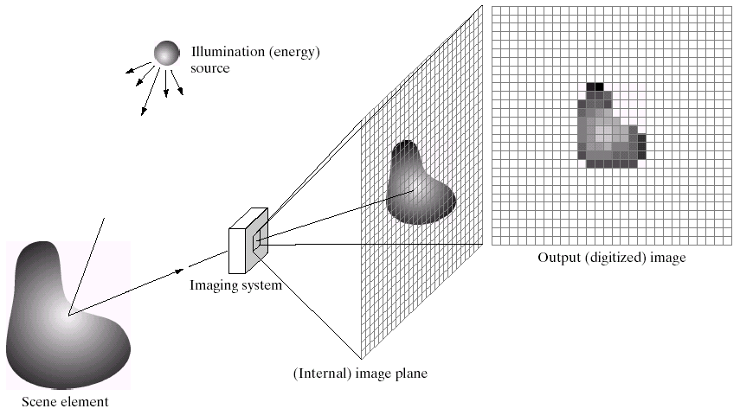

Key Stages in Digital Image Processing:
Image Aquisition
Sumber: Yacov Hel-Or, Image Processing, Spring 2010
Image Restoration
Morphological Processing
Image Enhancement
Segmentation
Image Acquisition
Object Recognition
Images taken from Gonzalez & Woods, Digital Image Processing (2002)
Representation & Description
Problem Domain
Colour Image Processing
Image Compression

Slide 4
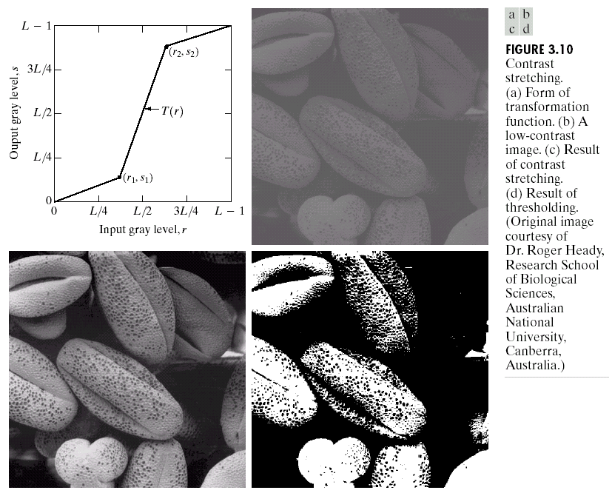
Key Stages in Digital Image Processing:
Image Enhancement
Sumber: Yacov Hel-Or, Image Processing, Spring 2010
Image Restoration
Morphological Processing
Image Enhancement
Segmentation
Image Acquisition
Object Recognition
Images taken from Gonzalez & Woods, Digital Image Processing (2002)
Representation & Description
Problem Domain
Colour Image Processing
Image Compression

Slide 5
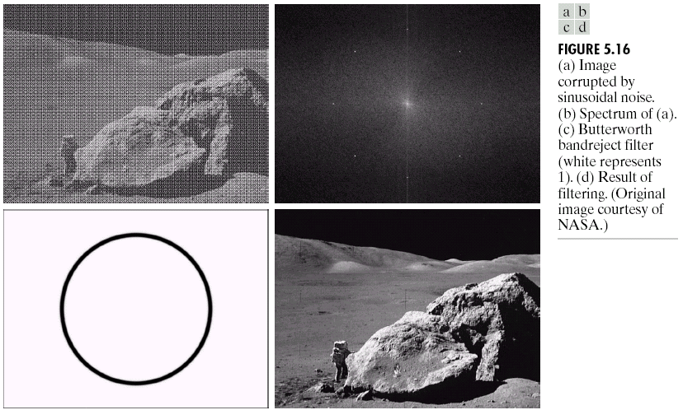
Key Stages in Digital Image Processing:
Image Restoration
Sumber: Yacov Hel-Or, Image Processing, Spring 2010
Image Restoration
Morphological Processing
Image Enhancement
Segmentation
Image Acquisition
Object Recognition
Images taken from Gonzalez & Woods, Digital Image Processing (2002)
Representation & Description
Problem Domain
Colour Image Processing
Image Compression

Slide 6
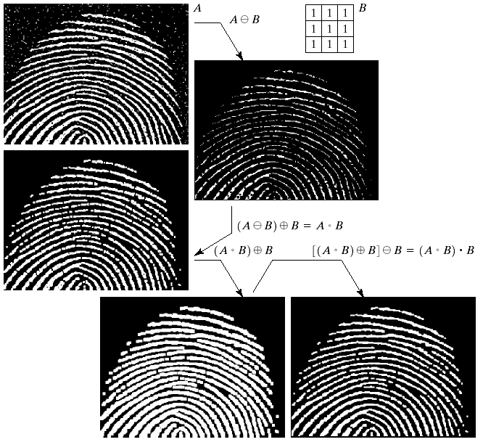
Key Stages in Digital Image Processing:
Morphological Processing
Sumber: Yacov Hel-Or, Image Processing, Spring 2010
Image Restoration
Morphological Processing
Image Enhancement
Segmentation
Image Acquisition
Object Recognition
Images taken from Gonzalez & Woods, Digital Image Processing (2002)
Representation & Description
Problem Domain
Colour Image Processing
Image Compression

Slide 7
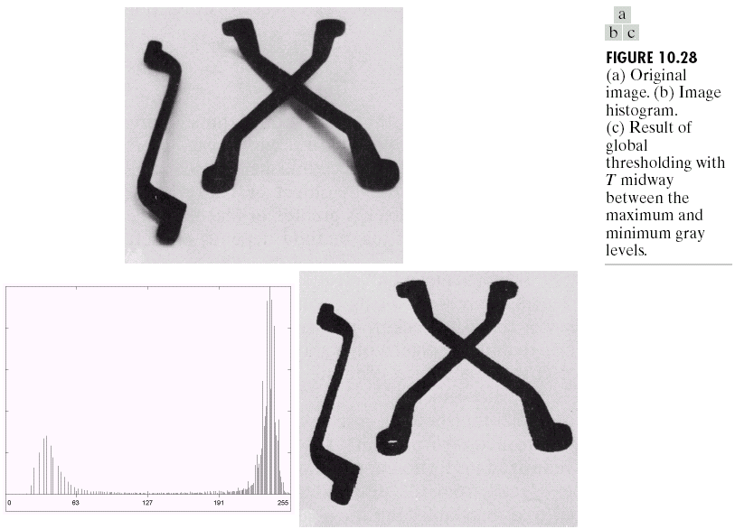
Key Stages in Digital Image Processing:
Segmentation
Sumber: Yacov Hel-Or, Image Processing, Spring 2010
Image Restoration
Morphological Processing
Image Enhancement
Segmentation
Image Acquisition
Object Recognition
Images taken from Gonzalez & Woods, Digital Image Processing (2002)
Representation & Description
Problem Domain
Colour Image Processing
Image Compression

Slide 8
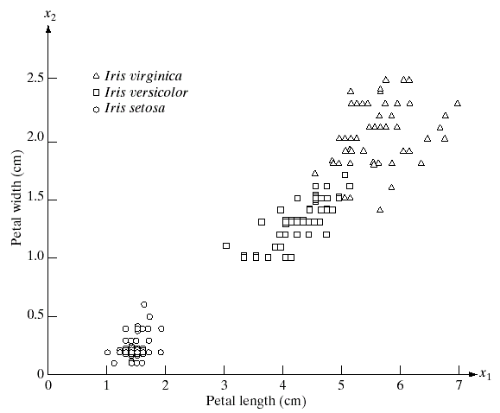
Key Stages in Digital Image Processing:
Object Recognition
Sumber: Yacov Hel-Or, Image Processing, Spring 2010
Image Restoration
Morphological Processing
Image Enhancement
Segmentation
Image Acquisition
Object Recognition
Images taken from Gonzalez & Woods, Digital Image Processing (2002)
Representation & Description
Problem Domain
Colour Image Processing
Image Compression

Slide 9
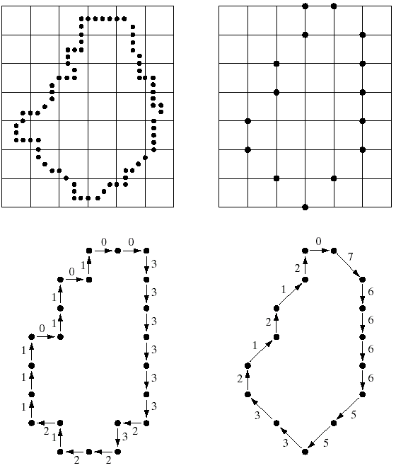
Key Stages in Digital Image Processing:
Representation & Description
Sumber: Yacov Hel-Or, Image Processing, Spring 2010
Image Restoration
Morphological Processing
Image Enhancement
Segmentation
Image Acquisition
Object Recognition
Images taken from Gonzalez & Woods, Digital Image Processing (2002)
Representation & Description
Problem Domain
Colour Image Processing
Image Compression

Slide 10
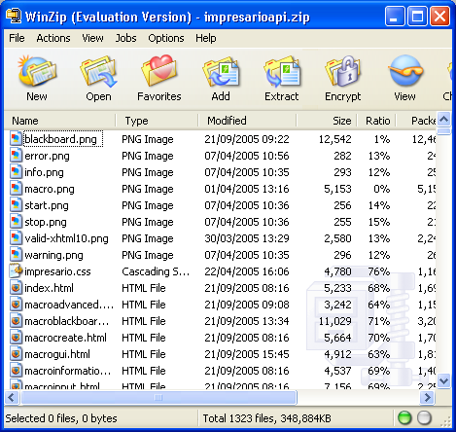
Key Stages in Digital Image Processing:
Image Compression
Sumber: Yacov Hel-Or, Image Processing, Spring 2010
Image Restoration
Morphological Processing
Image Enhancement
Segmentation
Image Acquisition
Object Recognition
Representation & Description
Problem Domain
Colour Image Processing
Image Compression

Slide 11
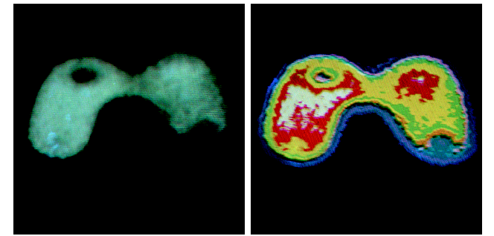
Key Stages in Digital Image Processing:
Colour Image Processing
Sumber: Yacov Hel-Or, Image Processing, Spring 2010
Image Restoration
Morphological Processing
Image Enhancement
Segmentation
Image Acquisition
Object Recognition
Representation & Description
Problem Domain
Colour Image Processing
Image Compression

Slide 12
Computer Vision
Computer vision merupakan proses otomatis yang mengintegrasikan sejumlah besar proses untuk persepsi visual, seperti akuisisi citra, pengolahan citra, klasifikasi, pengenalan (recognition), dan membuat keputusan.
Computer vision terdiri dari teknik-teknik untuk mengestimasi ciri-ciri objek di dalam citra, pengukuran ciri yang berkaitan dengan geometri objek, dan menginterpretasi informasi geometri tersebut.
Vision = Geometry + Measurement + Interpretation

Slide 13
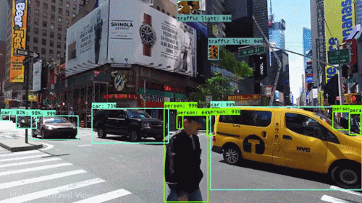
Computer Vision
Sumber: https://towardsdatascience.com/what-even-is-computer-vision-531e4f07d7d0

Slide 14
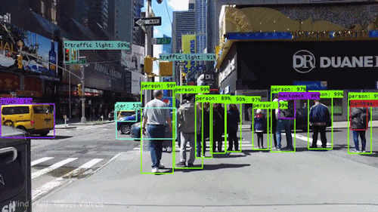
Sumber: https://towardsdatascience.com/everything-you-ever-wanted-to-know-about-computer-vision-heres-a-look-why-it-s-so-awesome-e8a58dfb641e

Slide 15
Pada hakikatnya, computer vision mencoba meniru cara kerja sistem visual manusia (human vision).
Human vision sesungguhnya sangat kompleks. Manusia melihat objek dengan indera penglihatan (mata), lalu citra objek diteruskan ke otak untuk diinterpretasi sehingga manusia mengerti objek apa yang tampak dalam pandangan matanya.
Hasil interpretasi ini mungkin digunakan untuk pengambilan keputusan (misalnya menghindar kalau melihat mobil melaju di depan).

Slide 16
Proses-proses di dalam computer vision dapat dibagi menjadi tiga aktivitas:
Memperoleh atau mengakuisisi citra digital.
Melakukan teknik komputasi untuk memperoses atau memodifikasi data citra (operasi-operasi pengolahan citra).
Menganalisis dan menginterpretasi citra dan menggunakan hasil pemrosesan untuk tujuan tertentu, misalnya memandu robot, mengontrol peralatan, memantau proses manufaktur, dan lain-lain.

Slide 17
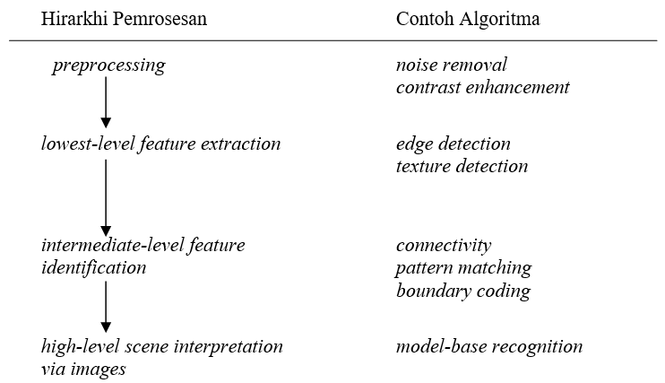
Proses-proses di dalam computer vision dalam hirarkhi sebagai berikut :

Slide 18
Image Processing → Computer Vision
Rangkaian kesatuan dari image processing ke computer vision dapat dipecah menjadi low-, mid- dan high-level processes
Low Level Process
Mid Level Process
High Level Process
Input: Image
Output: Image
Examples: Noise removal, image sharpening
Input: Image
Output: Attributes
Examples: Object detection and recognition, segmentation
Input: Attributes
Output: Understanding
Examples: scene understanding, autonomous navigation
Kuliah IF4073 sampai di sini saja
Sumber: Yacov Hel-Or, Image Processing, Spring 2010
Notes:
Give the analogy of the character recognition system.
Low Level: Cleaning up the image of some text
Mid level: Segmenting the text from the background and recognising individual characters
High level: Understanding what the text says

Slide 19
Image Processing v.s. Computer Vision
Low Level
Image Processing
Acquisition, representation,
compression, transmission
image enhancement
edge/feature extraction
Pattern matching
image "understanding“
(Recognition, 3D)
Computer Vision
High Level
Sumber: Yacov Hel-Or, Image Processing, Spring 2010

Slide 20
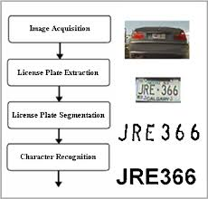

Slide 21
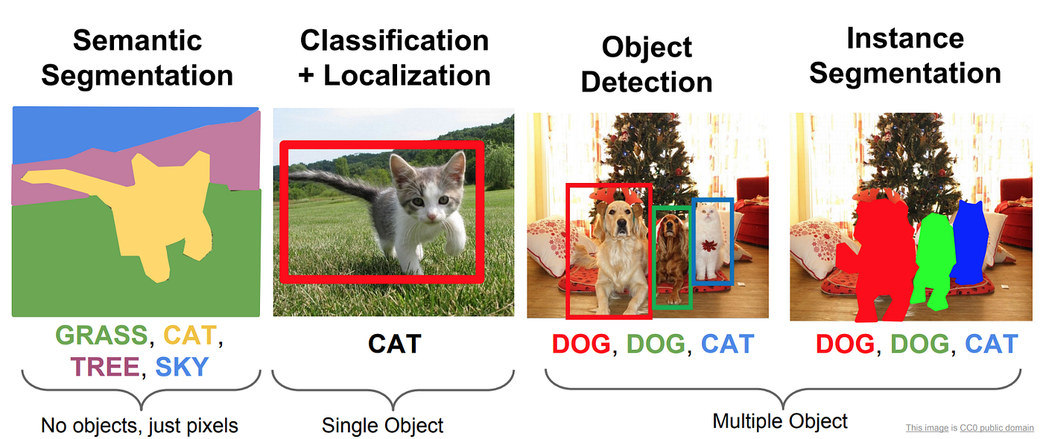

Slide 23
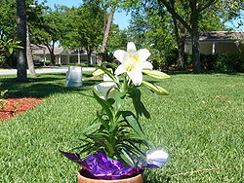
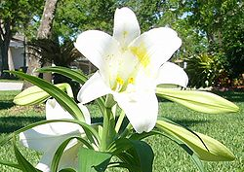
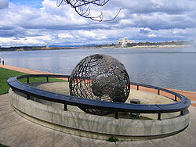
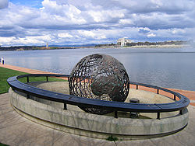
Aplikasi Pengolahan Citra (dan Computer Vision)
Image editing …
1. Cropping
2. Removal
of unwanted
element

Slide 24
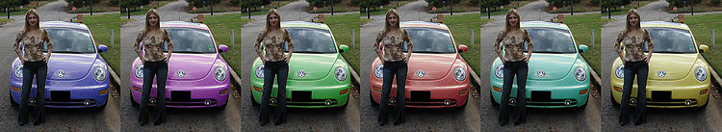
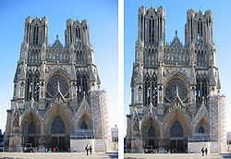
Aplikasi Pengolahan Citra (dan Computer Vision)
Image editing …
3. Selective color change
4. Perspective correction
and distortion

Slide 25
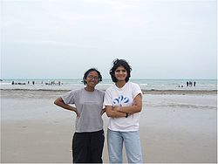
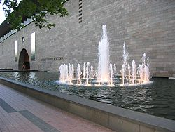
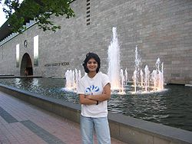
Aplikasi Pengolahan Citra (dan Computer Vision)
Image editing …
5. Selecting and merging of images

Slide 26
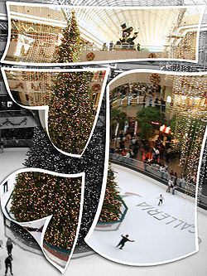
Aplikasi Pengolahan Citra (dan Computer Vision)
Image editing
6. Special effects

Slide 27
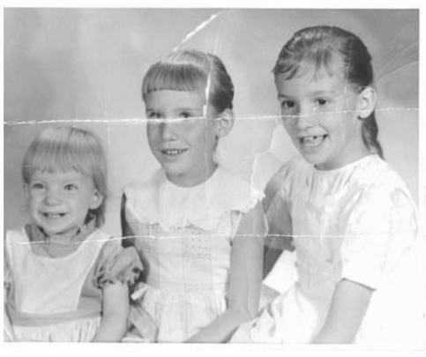

Image Inpainting 1
Aplikasi Pengolahan Citra (dan Computer Vision)
Sumber: Yacov Hel-Or, Image Processing, Spring 2010

Slide 28
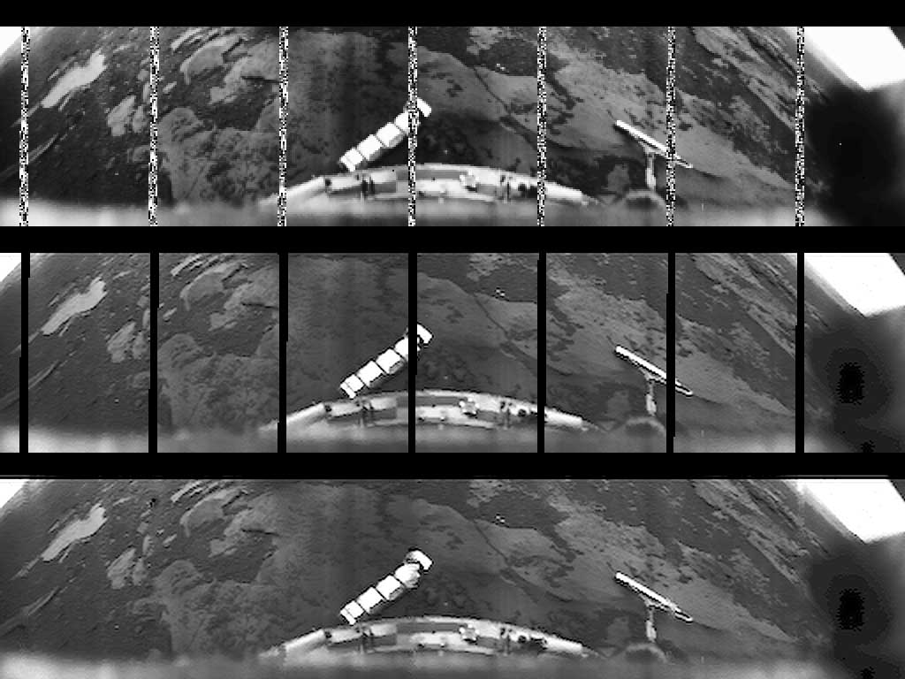
Image Inpainting 2
Aplikasi Pengolahan Citra (dan Computer Vision)
Yacov Hel-Or, Image Processing, Spring 2010
Images of Venus taken by the Russian lander Ventra-10 in 1975
Sumber: Yacov Hel-Or, Image Processing, Spring 2010

Slide 29
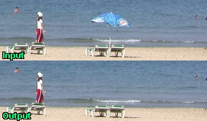
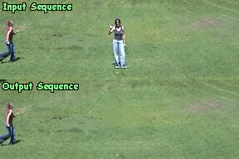
Video Inpainting
Aplikasi Pengolahan Citra (dan Computer Vision)
Y. Wexler, E. Shechtman and M. Irani 2004
Sumber: Yacov Hel-Or, Image Processing, Spring 2010

Slide 30
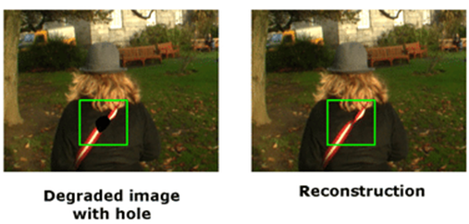
Video Inpainting

Slide 31
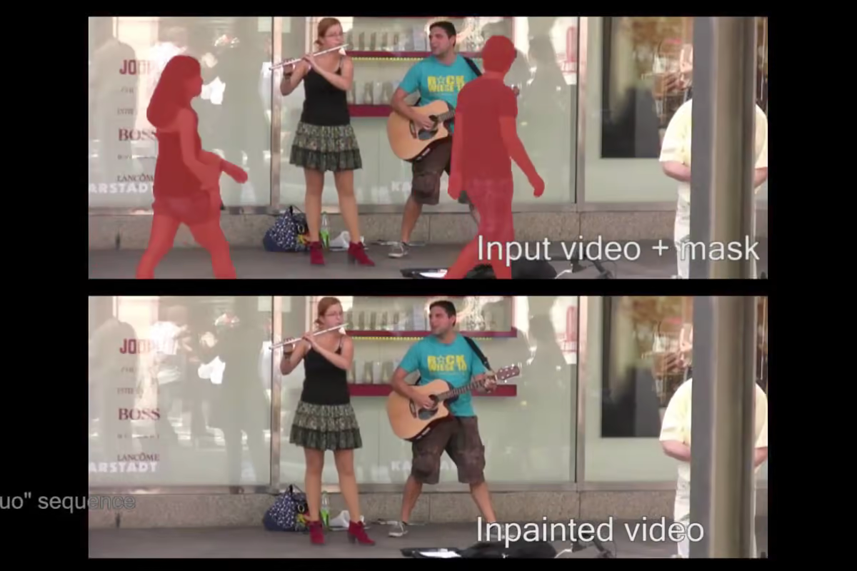
https://newatlas.com/video-inpainting-software-hd/26632/

Slide 32
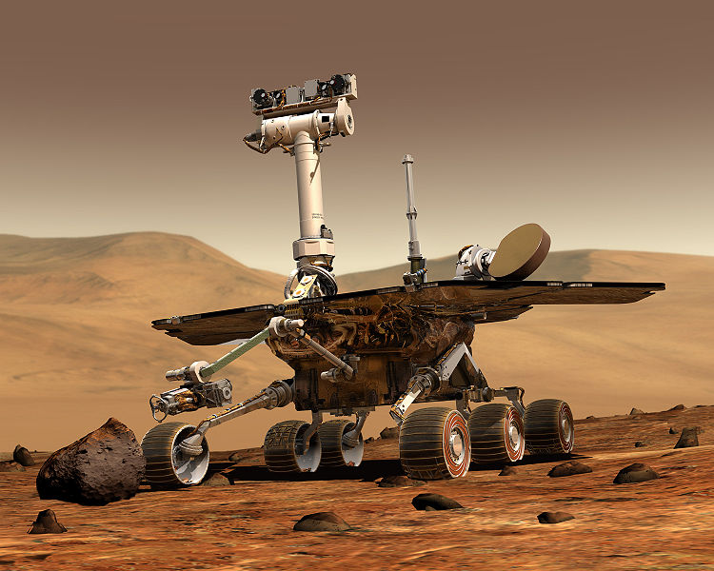
Aplikasi Pengolahan Citra (dan Computer Vision)
Robotika

Slide 33
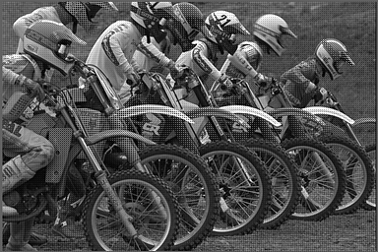
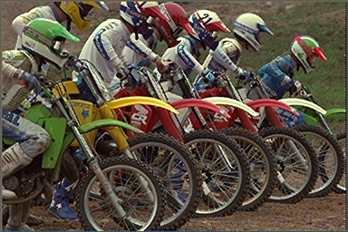
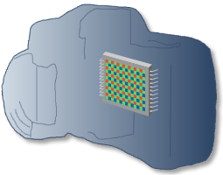
Image Demosaicing
Aplikasi Pengolahan Citra (dan Computer Vision)

Slide 34
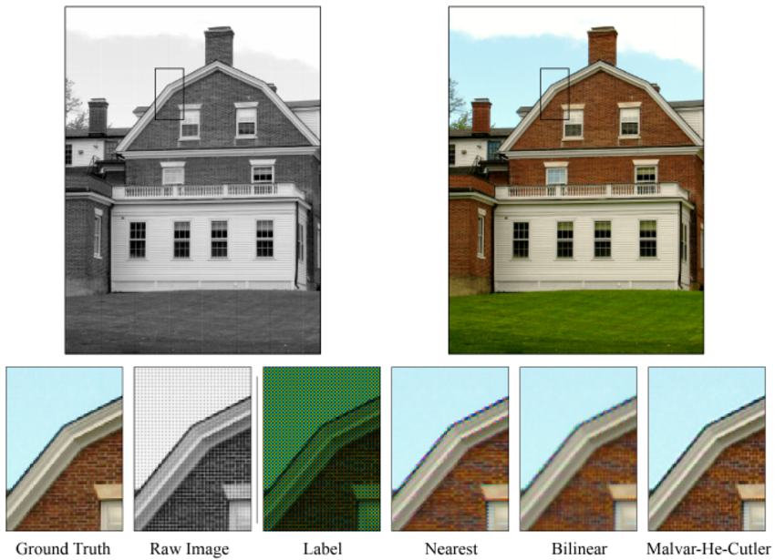
https://www.researchgate.net/figure/Comparision-of-common-demosaicing-methods-applied-to-an-image-of-a-brick-house-and-blue_fig2_220494111

Slide 35
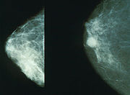
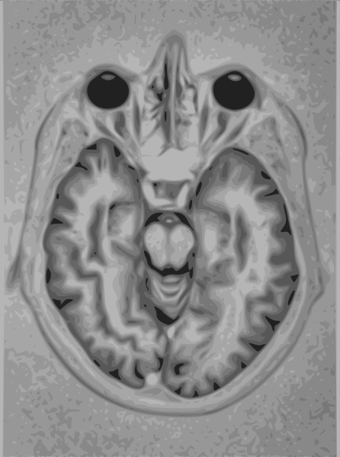
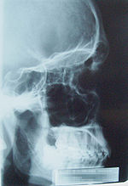
Aplikasi Pengolahan Citra (dan Computer Vision)
Medis
Normal (left) versus cancerous (right)
mammography image.
Magnetic resonance imaging
(MRI) of brain

Slide 36
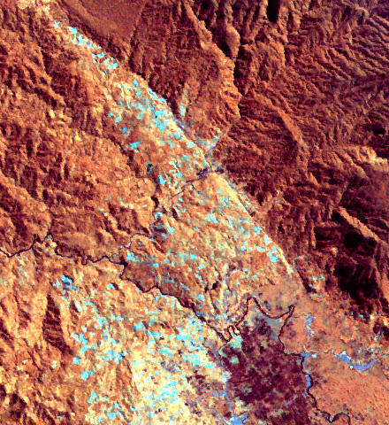
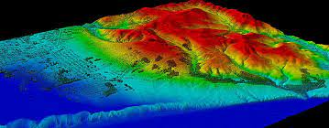
Aplikasi Pengolahan Citra (dan Computer Vision)
Remote sensing is the process of detecting and monitoring the physical characteristics of an area by measuring its reflected and emitted radiation at a distance (typically from satellite or aircraft). Special cameras collect remotely sensed images, which help researchers "sense" things about the Earth.
Remote sensing
https://www.usgs.gov/faqs/what-remote-sensing-and-what-it-used
https://oceanservice.noaa.gov/facts/remotesensing.html

Slide 37
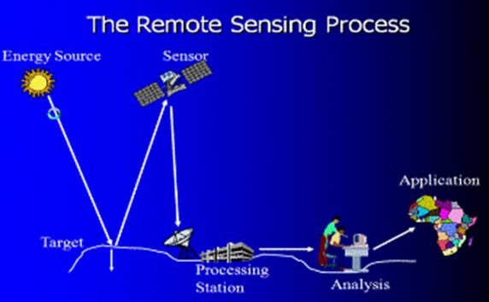
http://dgl.salemstate.edu/geography/profs/young/Imaging%20Earth/Glacier-webpage/home_Page301.htm

Slide 38
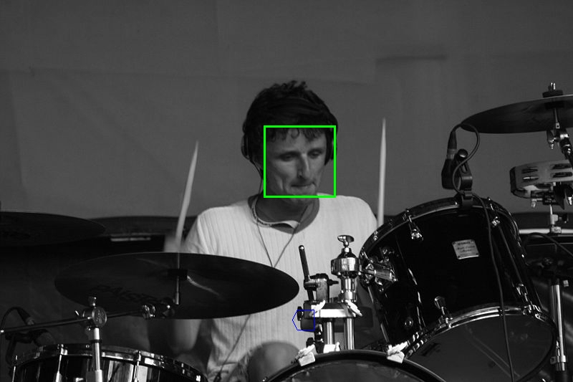
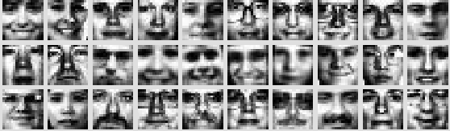
Aplikasi Pengolahan Citra (dan Computer Vision)
Face detection

Slide 39
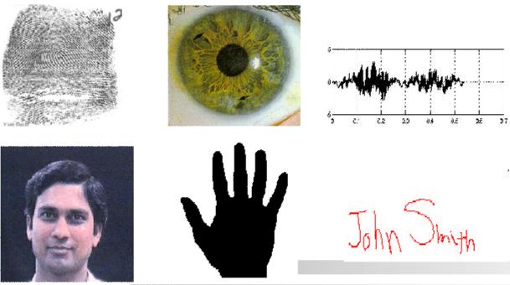
Biometrics
Aplikasi Pengolahan Citra (dan Computer Vision)
Sumber: Dr. Sanjeev Kumar, Mathematical Imaging Techniques, Department of Mathematics, IIT Roorkee

Slide 40
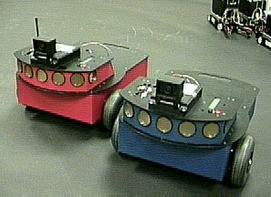
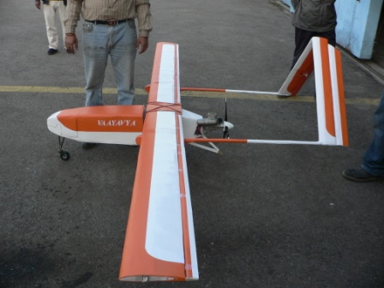
Autonomous Vehicles
Aplikasi Pengolahan Citra (dan Computer Vision)
Land, Underwater, Space
Sumber: Dr. Sanjeev Kumar, Mathematical Imaging Techniques, Department of Mathematics, IIT Roorkee

Slide 41
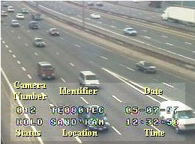
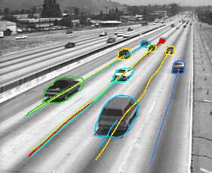
Traffic Monitoring
Aplikasi Pengolahan Citra (dan Computer Vision)
Kemacetan:
Lancar
Macet parah
Macet ringan
Sumber: Dr. Sanjeev Kumar, Mathematical Imaging Techniques, Department of Mathematics, IIT Roorkee

Slide 42
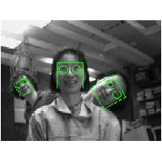
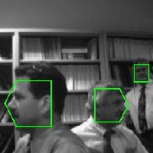
Face Detection
Aplikasi Pengolahan Citra (dan Computer Vision)
Sumber: Dr. Sanjeev Kumar, Mathematical Imaging Techniques, Department of Mathematics, IIT Roorkee

Slide 43

Face Recognition
Aplikasi Pengolahan Citra (dan Computer Vision)
Sumber: Dr. Sanjeev Kumar, Mathematical Imaging Techniques, Department of Mathematics, IIT Roorkee

Slide 44

Aplikasi Pengolahan Citra (dan Computer Vision)
Crack detection

Slide 45


Slide 46

Facial Expression Recognition
Aplikasi Pengolahan Citra (dan Computer Vision)
Ekspresi:
Sedih
Gembira
Marah
Kaget
Netral
Sumber: Dr. Sanjeev Kumar, Mathematical Imaging Techniques, Department of Mathematics, IIT Roorkee

Slide 47

Hand Gesture Recognition
Aplikasi Pengolahan Citra (dan Computer Vision)
Smart Human-Computer User Interfaces
Sign Language Recognition
Sumber: Dr. Sanjeev Kumar, Mathematical Imaging Techniques, Department of Mathematics, IIT Roorkee

Slide 48

Human Activity Recognition
Aplikasi Pengolahan Citra (dan Computer Vision)
Sumber: Dr. Sanjeev Kumar, Mathematical Imaging Techniques, Department of Mathematics, IIT Roorkee

Slide 49


Medical Applications
Aplikasi Pengolahan Citra (dan Computer Vision)
skin cancer breast cancer
Sumber: Dr. Sanjeev Kumar, Mathematical Imaging Techniques, Department of Mathematics, IIT Roorkee

Slide 50


Image Morphing
Aplikasi Pengolahan Citra (dan Computer Vision)
Sumber: Dr. Sanjeev Kumar, Mathematical Imaging Techniques, Department of Mathematics, IIT Roorkee

Slide 51

Aplikasi Pengolahan Citra (dan Computer Vision)
An image retrieval system is a computer system for browsing, searching and retrieving images from a large database of digital images
Sumber: https://www.analyticsvidhya.com/blog/2017/11/information-retrieval-using-kdtree/

Slide 52

Aplikasi Pengolahan Citra (dan Computer Vision)
Object Detection
Video di Youtube: https://www.youtube.com/watch?v=MPU2HistivI&t=34s

Slide 53

Aplikasi Pengolahan Citra (dan Computer Vision)
Human tracking

Slide 54


Scene understanding
Aplikasi Pengolahan Citra (dan Computer Vision)

Slide 55

Scene understanding

Slide 56
Aplikasi Pengolahan Citra (dan Computer Vision)
Image forgery detection
Sumber: https://www.sciencedirect.com/science/article/pii/S266591072030061X

Slide 57

Image forgery detection

Slide 58


Beberapa TA/Tesis tentang Image Processing dan Computer Vision
Ahmad Faishol Huda (13516094): Pengembangan Sistem Pencarian Gambar Produk E-commerce Dengan Convolutional Neural Network

Slide 59

Hagai Raja Sinulingga (13516136): Sistem Pengenalan Jalan Raya Pada Sistem Autonomous Vehicle (Av) Dengan Metode Heuristik Dan Pembelajaran Mesin

Slide 60

Renjira Naufhal Dhiaegana (13516014): Penerapan Convolutional Neural Network Untuk Deteksi Pedestrian Pada Sistem Autonomous Vehicle

Slide 61
Trian Annas Thoriq Sumarjadi (13516148): Pembangunan Model Clustering Untuk Pengelompokan Citra Near Duplicate

Slide 62

5. Abel Stanley (13517068): Pengembangan Sistem Penghitung Volume Kendaraan Lalu Lintas Pada Video Cctv Dengan Algoritma YOLO dan Segmentasi Semantik Berbasis Model Warna Hsv Jalan

Slide 63
6. Asif Hummam Rais (13517099): Inferensi Kecepatan Kendaraan Menggunakan Yolo, Filter Kalman, Dan Pensampelan Bingkai

Slide 64
7. Michelle Theresia (13518050): Pendeteksian Image Forgery Kelas Spliced Image Pada Aplikasi Pesan Instan

Slide 65
8. Fauzan Firdaus (23520011): Pengenalan Wajah Bermasker Menggunakan Deep Learning

Slide 66

9. Nadya Aditama (23520039): Estimasi Kalori Pada Jajanan Pasar Di Indonesia Menggunakan Mask R-cnn Dan Regresi Linear Berganda

Slide 67
Citra Uji Standard
Terdapat sejumlah citra yang sering dipakai sebagai citra uji di dalam pengolahan citra atau computer vision.
Citra-citra tersebut sering disebut sebagai standard test image, baik citra grayscale maupun citra berwarna.
Umumnya citra uji berukuran persegi (N x N) untuk memudahkan beberapa operasi pengolahan citra yang mengasumsikan citra masukan sebagai citra persegi.
Empat citra uji standard yang popular dan digunakan secara luas adalah citra Lena, mandrill, camera, dan pepper.
Koleksi citra uji dapat dilihat di laman situs web saya: http://informatika.stei.itb.ac.id/~rinaldi.munir/Koleksi/Citra%20Uji/CitraUji.htm

Slide 68



Slide 69





Citra uji lainnya:
Empat citra popular dalam bidang image processing

Slide 70
Koleksi standar citra uji lainnya:
The USC-SIPI Image Database
https://sipi.usc.edu/database/
2. Computer vision test images
https://www.cs.cmu.edu/afs/cs/project/cil/ftp/html/v-images.html
3. TESTIMAGES
https://testimages.org/

Slide 71

Sejarah Citra Lena
Lenna atau Lena adalah nama citra uji standard yang digunakan secara luas di dalam bidang pengolahan citra sejak tahun 1973.
Lena adalah citra seorang model Swedia bernama Lena Söderberg, yang dipotong dari majalah Playboy.
Foto Lena dari majalah tersebut dipindai oleh Alexander Sawchuk, dia memerlukan foto wajah untuk ditampilkan di dalam sebuah artikel ilmiahnya di sebuah konferensi IEEE.
Alasan penggunaan citra Lena sebagai citra uji adalah karena citra ini memiliki detil yang bagus, tekstur, dan bayangan, tetapi yang paling penting adalah nilai-nilai pixel-nya tersebar secara merata (histogram).
Tidak dipungkiri juga alasan karena ia seorang wanita cantik, seorang model, dan seorang artis.

Slide 72



Slide 73
Sejarah pertama kali citra Lenna dipakai sebagai citra uji ditulis sebagai berikut:
Alexander Sawchuk estimates that it was in June or July of 1973 when he, then an assistant professor of electrical engineering at the University of Southern California Signal and Image Processing Institute (SIPI), along with a graduate student and the SIPI lab manager, was hurriedly searching the lab for a good image to scan for a colleague's conference paper. They got tired of their stock of usual test images, dull stuff dating back to television standards work in the early 1960s. They wanted something glossy to ensure good output dynamic range, and they wanted a human face. Just then, somebody happened to walk in with a recent issue of Playboy.
The engineers tore away the top third of the centerfold so they could wrap it around the drum of their Muirhead wirephoto scanner, which they had outfitted with analog-to-digital converters (one each for the red, green, and blue channels) and a Hewlett Packard 2100 minicomputer. The Muirhead had a fixed resolution of 100 lines per inch and the engineers wanted a 512×512 image, so they limited the scan to the top 5.12 inches of the picture, effectively cropping it at the subject's shoulders.
Sumber: Wikipedia

Slide 74



Lena Söderberg tahun 1997:
Currently, Lenna lives near Stockholm and works for a government agency supervising handicapped employees archiving data using, appropriately, computers and scanners.
Sumber: http://www.ee.cityu.edu.hk/~lmpo/lenna/Lenna97.html

Slide 75

Lena saat ini:
I discovered that the last time she’d appeared in public was in 2015, as a “special guest” at an image processing industry conference in Quebec City.
“I’m just surprised that it never ends,” Forsen says about her unusual fame.
Sumber: https://www.wired.com/story/finding-lena-the-patron-saint-of-jpegs/

Slide 76
Sumber bahan ajar ini
Yacov Hel-Or, Image Processing, Spring 2010
Dr. Sanjeev Kumar, Mathematical Imaging Techniques, Department of Mathematics, IIT Roorkee

